Slide 1


Project Management using
Slides created by: Itay Bouganim
GitHub

Slide 2
Defining Tasks
Start with an issue –
Use GitHub issues – issues can be treated as a task.
Create an issue to suggest and track a new idea, requirement or track a bug.
Issues description support most image and file types.
You can also add links to relevant documentation or websites.
A checklist can also be added to your issue to track sub-tasks that need to be completed in order to solve or complete the issue.
Another option is to reference other users/teams associated with the repository in the issue or even reference to other issue or pull request (Will be expanded later).

Slide 3
Defining Tasks
With each issue opened you can:
Assign a person or group that will work on the issue
Assign a label that categorizes the issue. You can use the built-in labels and create your own to suit your needs.
Assign to a project. We will see more about projects later.
Close the issue with the reason it was closed (e.g. it was fixed and how, could not reproduce, etc.)

Slide 4
Defining Tasks
Commits and issues:
When you create a commit (commit changes to your repository), you can associate a commit with an issue by putting Issue #X, e.g. Issue #1, at the beginning of your commit message. GitHub will automatically link that commit to the issue and show it in the issue details.
Example commit message:

Slide 5
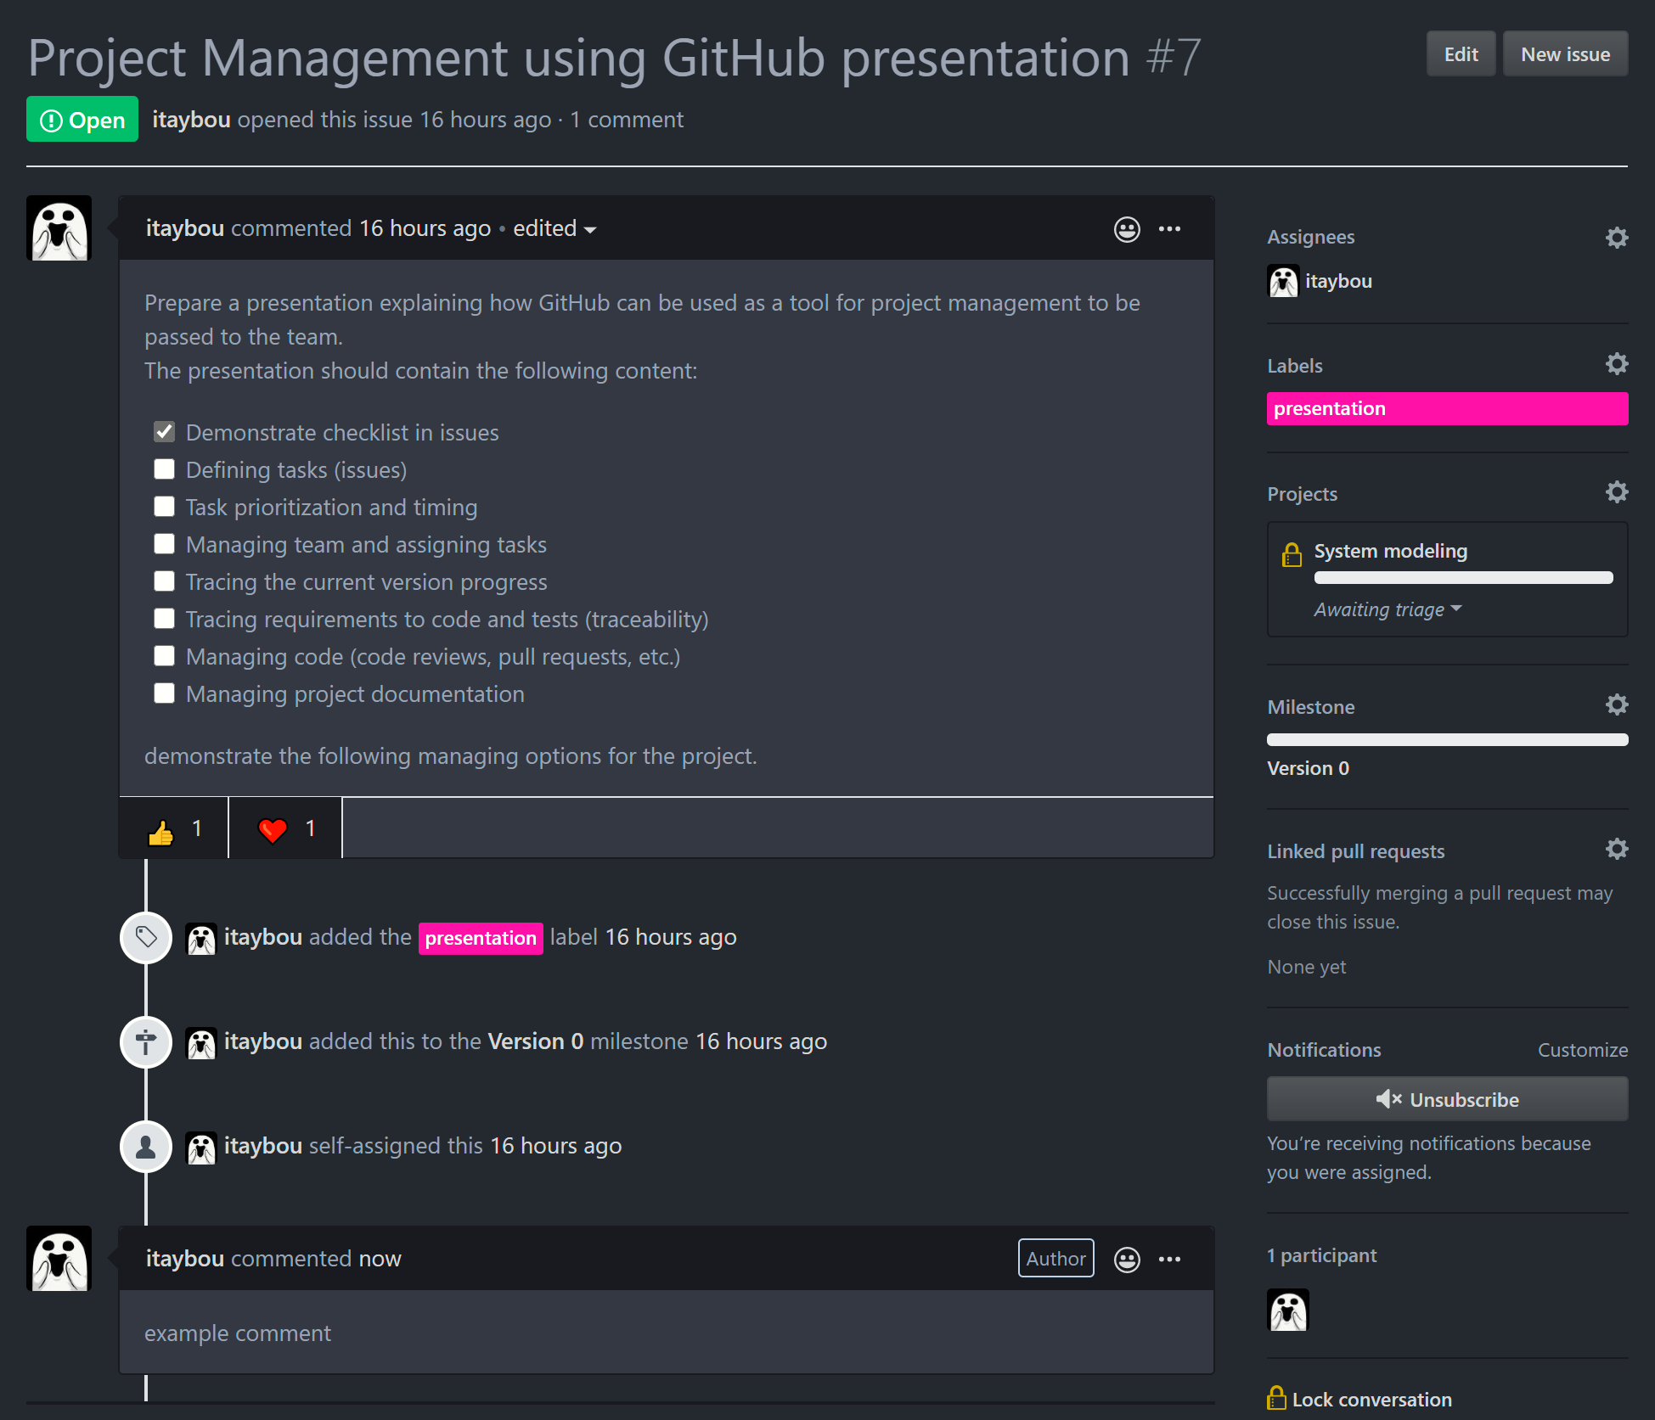
Defining Tasks
Example issue:
You can react to an issue
Activity made around that issue is also presented
Comments can be made/viewed

Slide 6
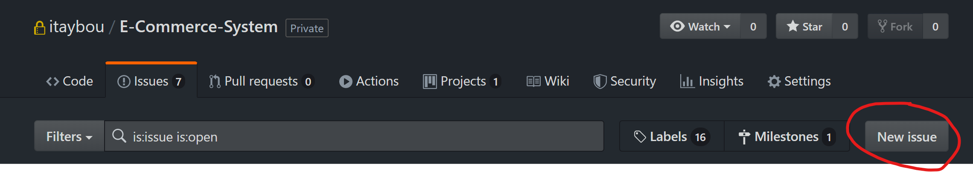
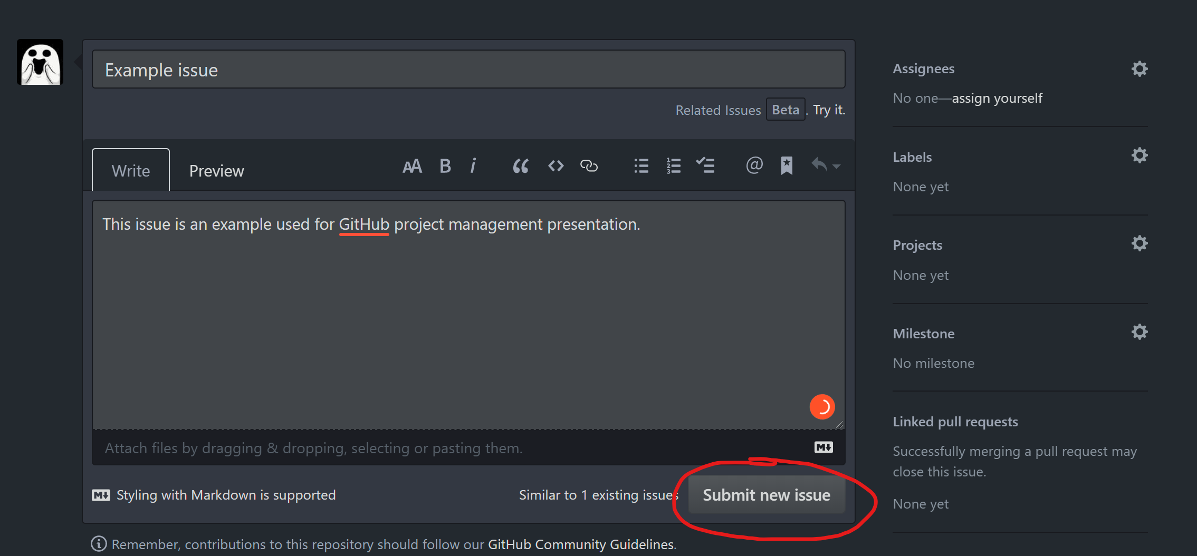
Defining Tasks
Opening an issue –
Describe the issue and submit -

Slide 7
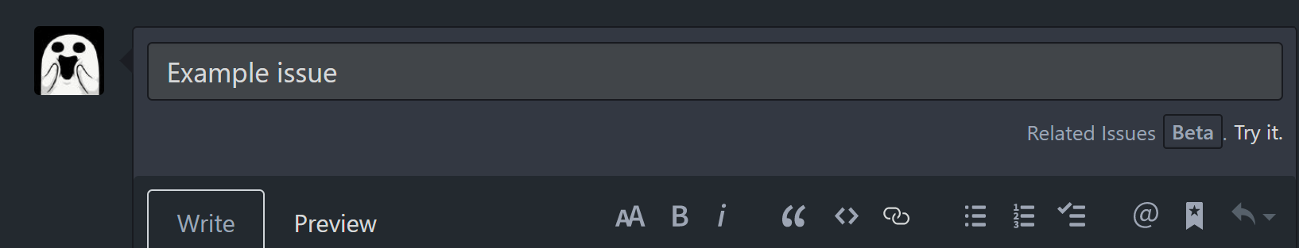
Defining Tasks
Your newly added issue can also support the following –
Issue title
Preview how the issue will look after submitted
Create a checklist
Mention other user/team
Reference other issue or pull request

Slide 8
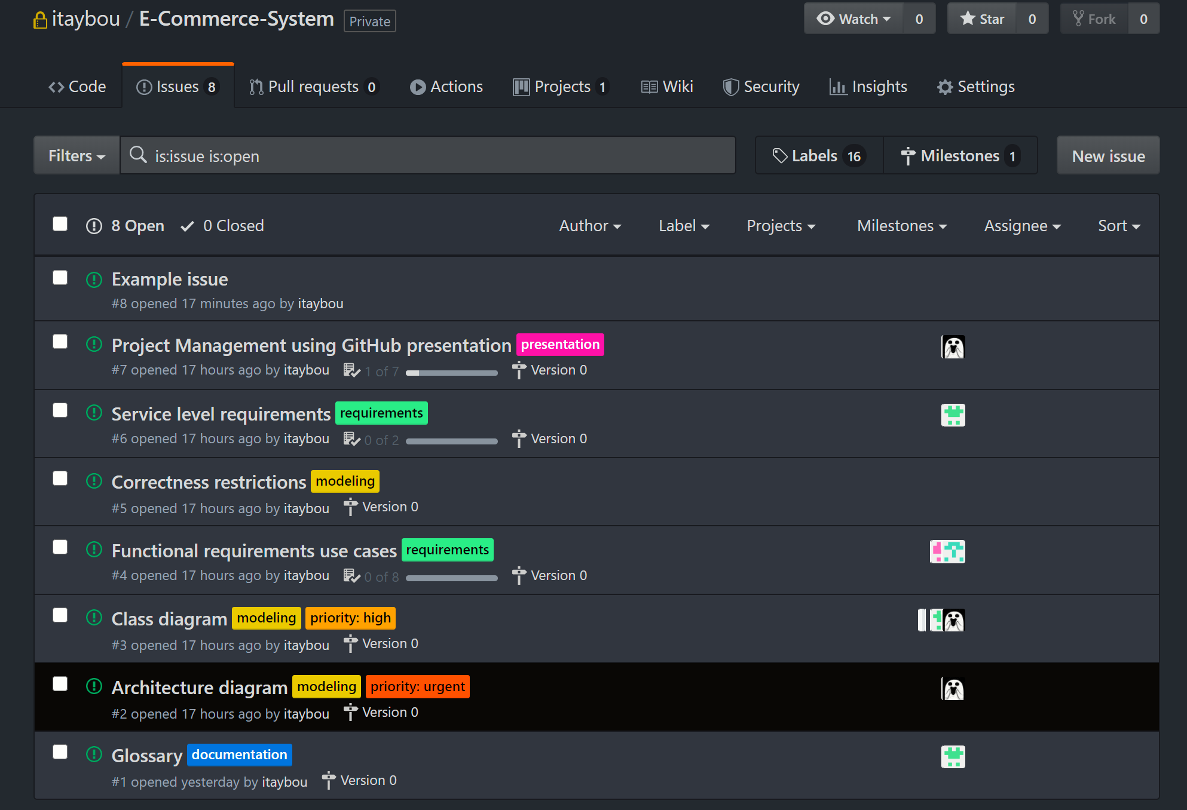
Defining Tasks
After a few issues have opened –
Our new submitted issue
Issue checklist progress bar
Previously opened issues

Slide 9
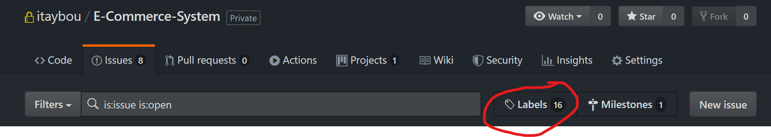
Creating issue labels
You can create or use existing labels to tag issues in order to make it easier for other users to classify the subject of the issue.
Labels can also be used as a way to annotate an issue with custom parameters such as: priority, status, effort, etc.
Press the labels tab under the issues tab in order to manage your repository labels.

Slide 10
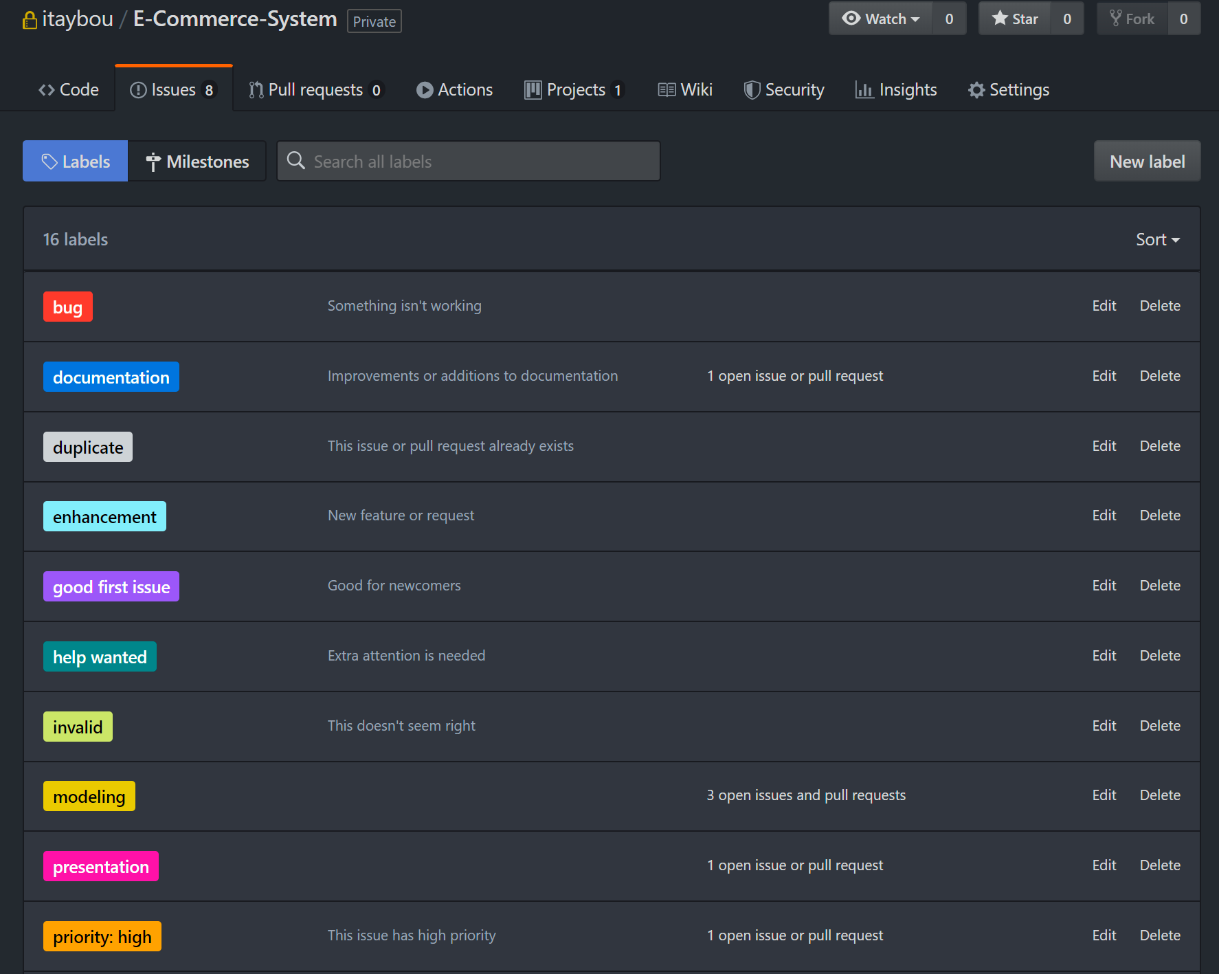
Creating issue labels
Create a new labels allows you to provide the name of the label that will be presented in the tag, a short description of the purpose of the label and a color that will be used in the label tag.
You can create new labels, edit existing or delete labels.

Slide 11
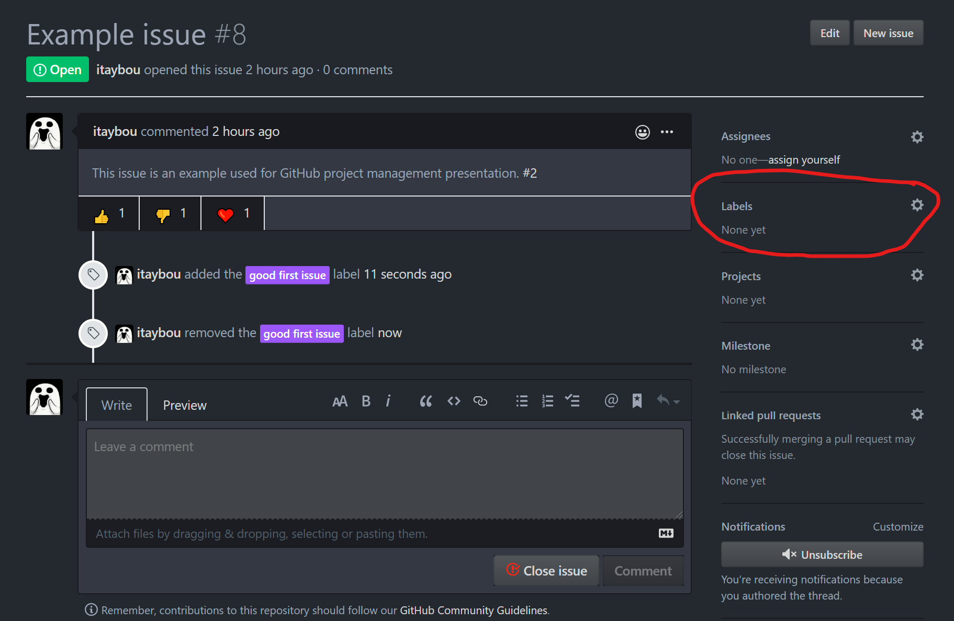
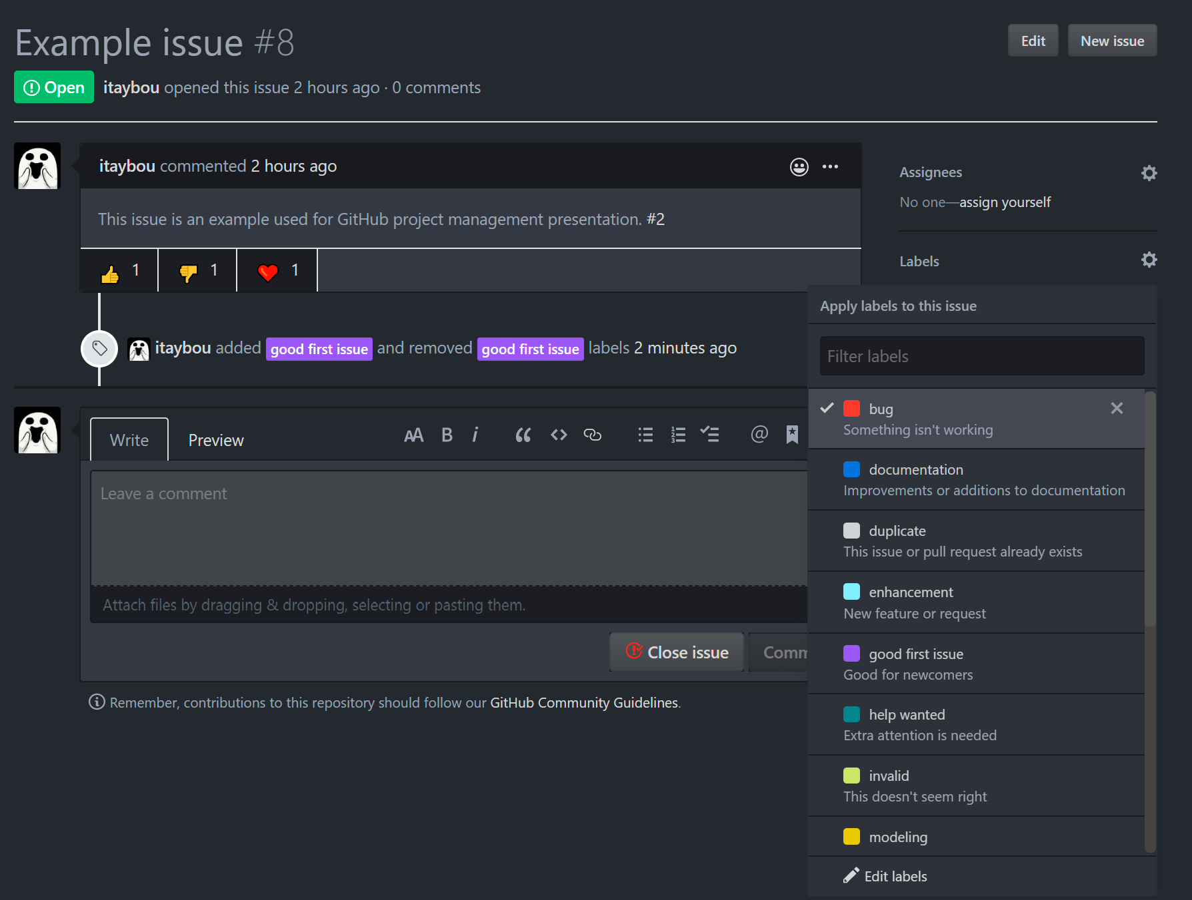
Creating issue labels
Labels can be assigned to issues through the issue page:
Choose labels that are relevant for the issue

Slide 12
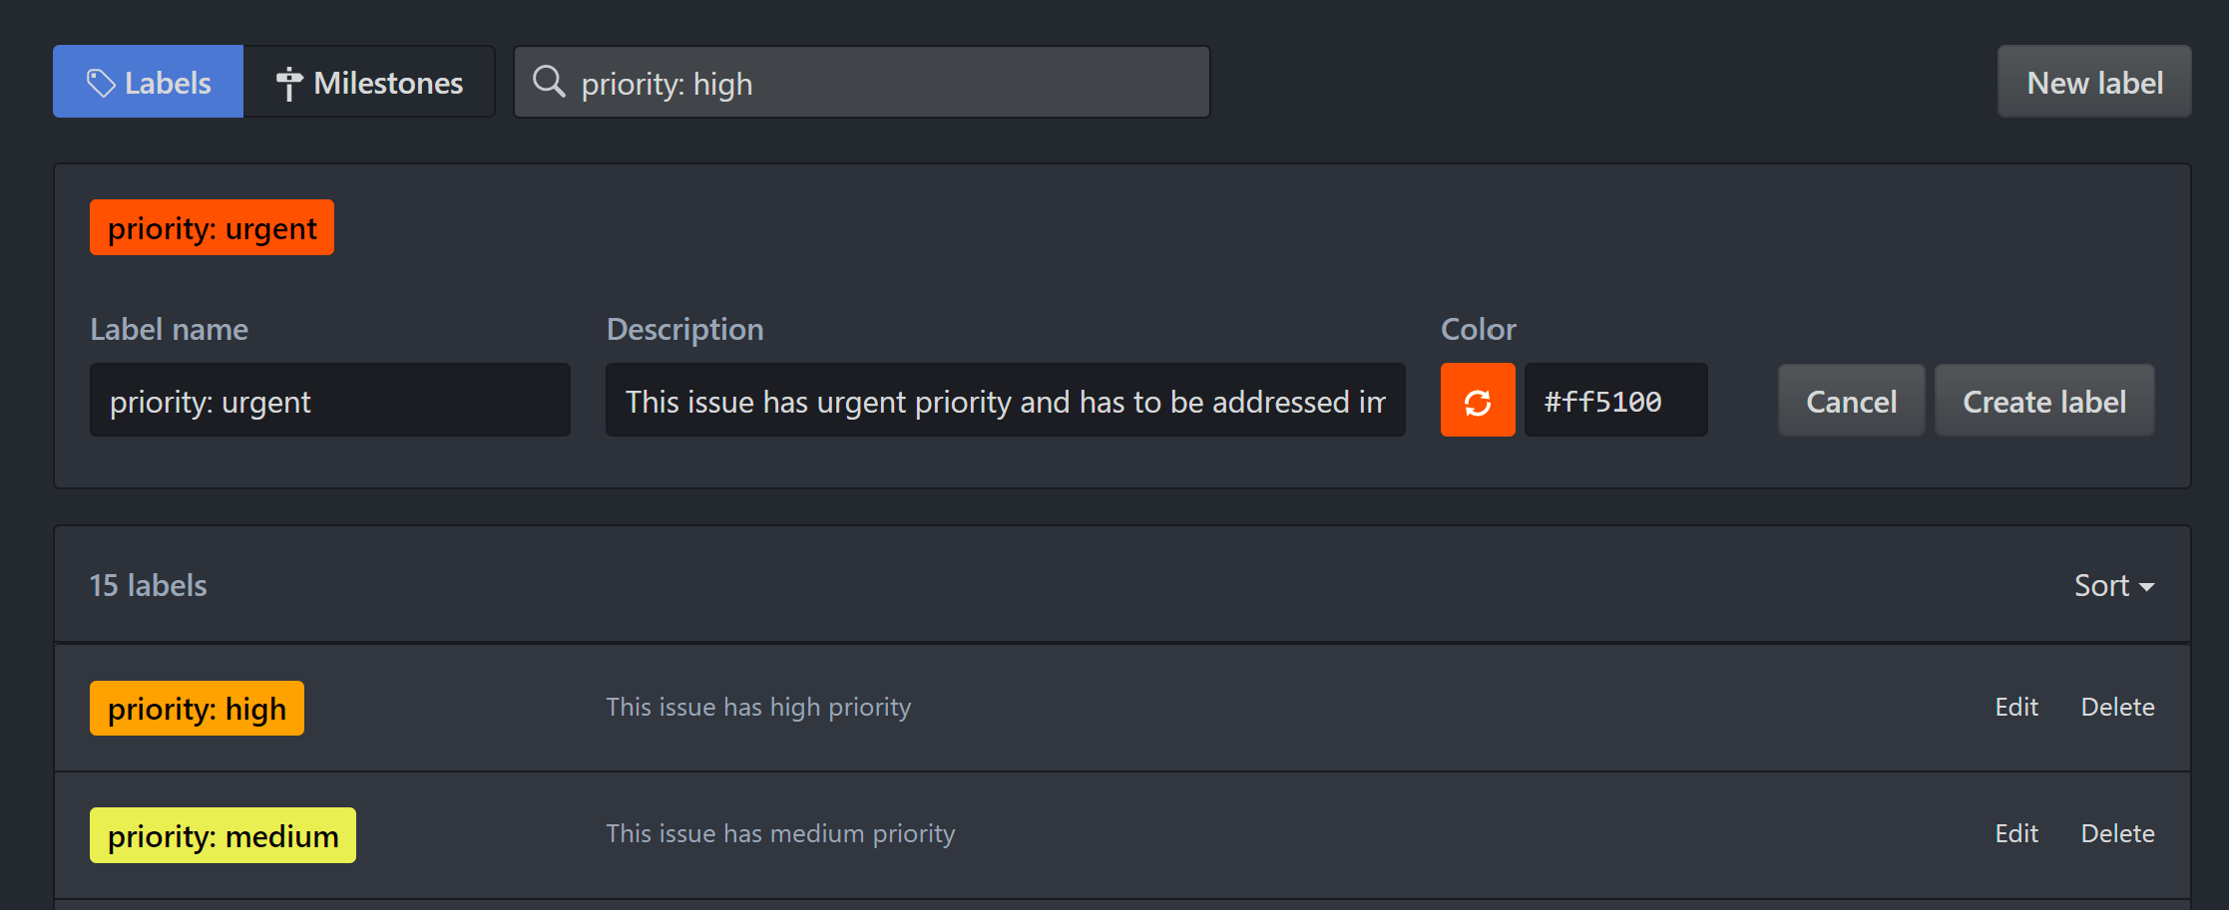
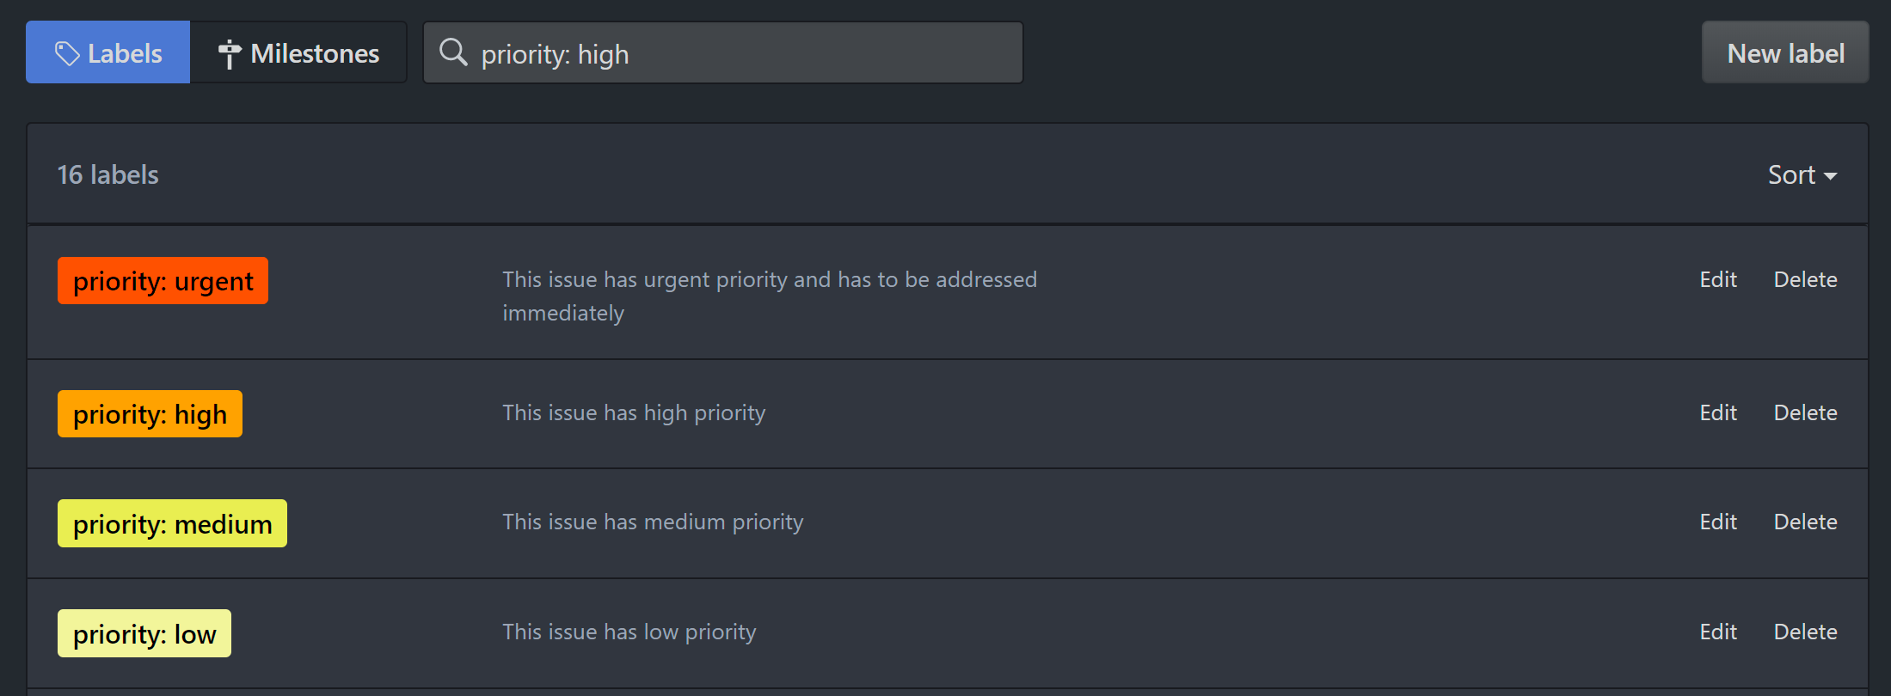
Using labels to prioritize issues
We will create a few labels that will describe the priority of the issue

Slide 13
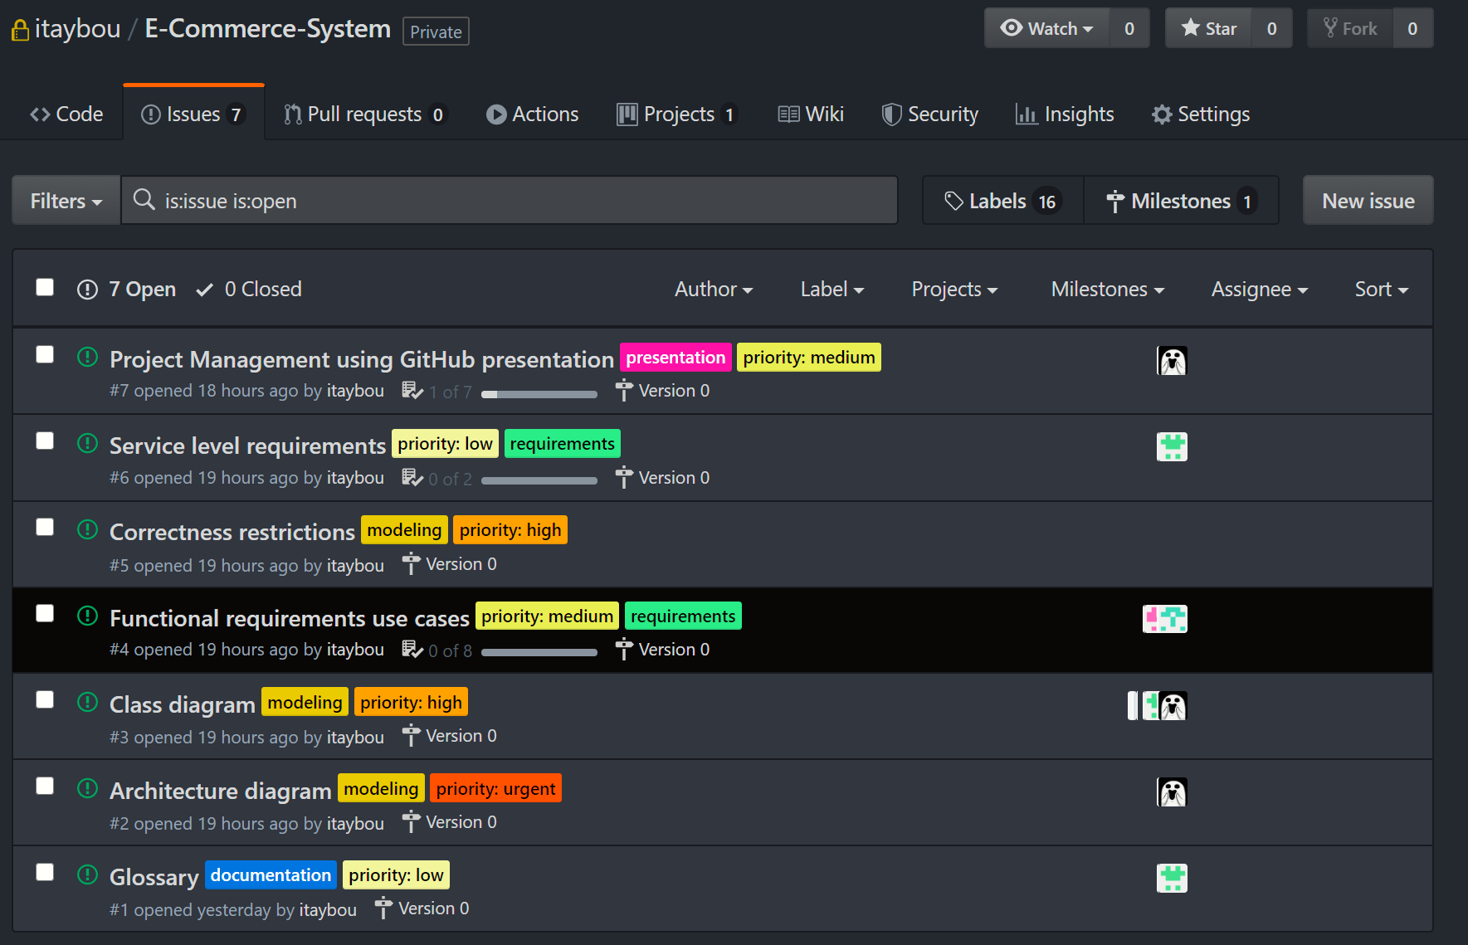
Using labels to prioritize issues
Issue filtering options
Issue filtering options
After annotating all of our issues with the priority labels (And additional labels) we can filter the issues by the priority (and the rest of the labels) and address them accordingly.

Slide 14
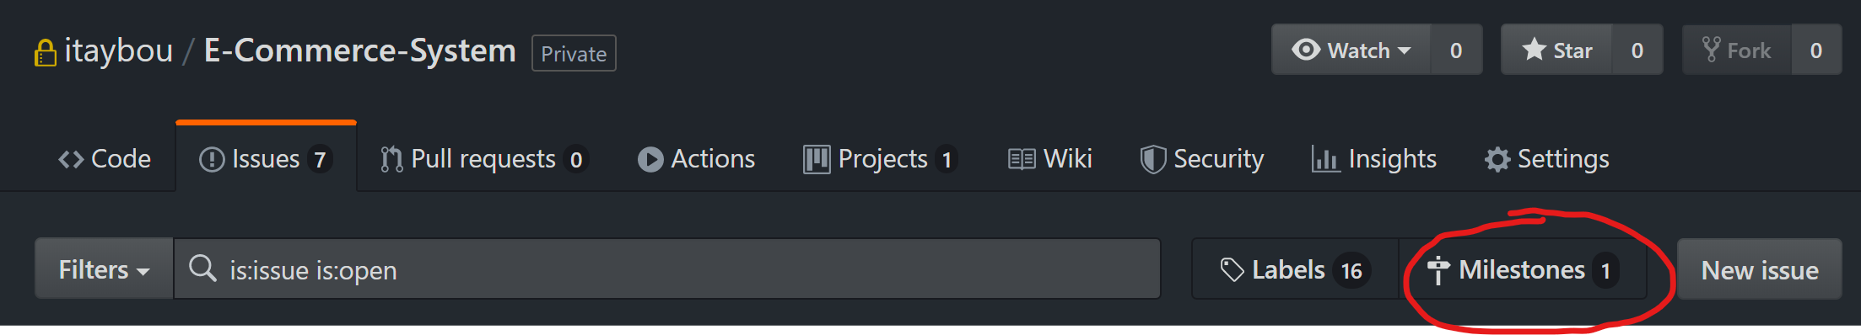
Scheduling tasks using milestones
What are Milestones?
Collections of Issues and Pull Requests for a particular release or project.
Can have a due date.

Slide 15
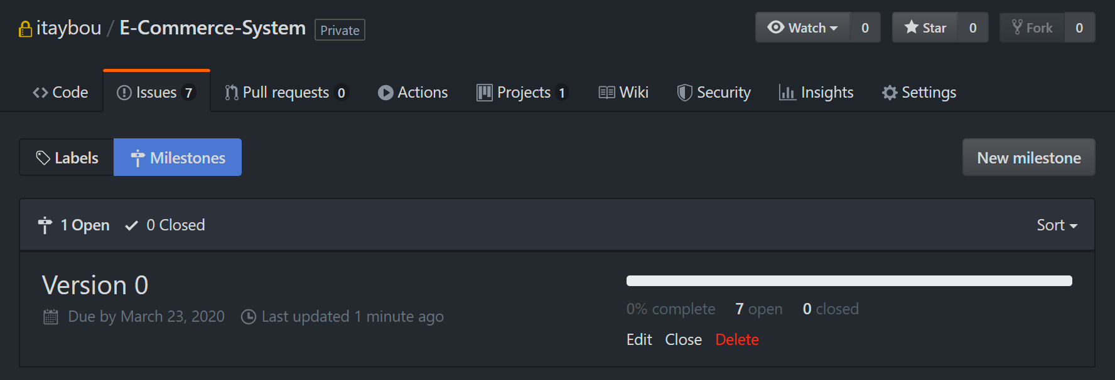
Scheduling tasks using milestones
You can use milestones to track progress on collection of issues and pull requests in a repository.
You can schedule a due date on a milestone.
When you create a milestone, you can associate it with issues and pull requests.
To better manage your project, you can view details about your milestone. From the milestone page.
Milestone progress
Due date for the milestone
Create a new milestone

Slide 16
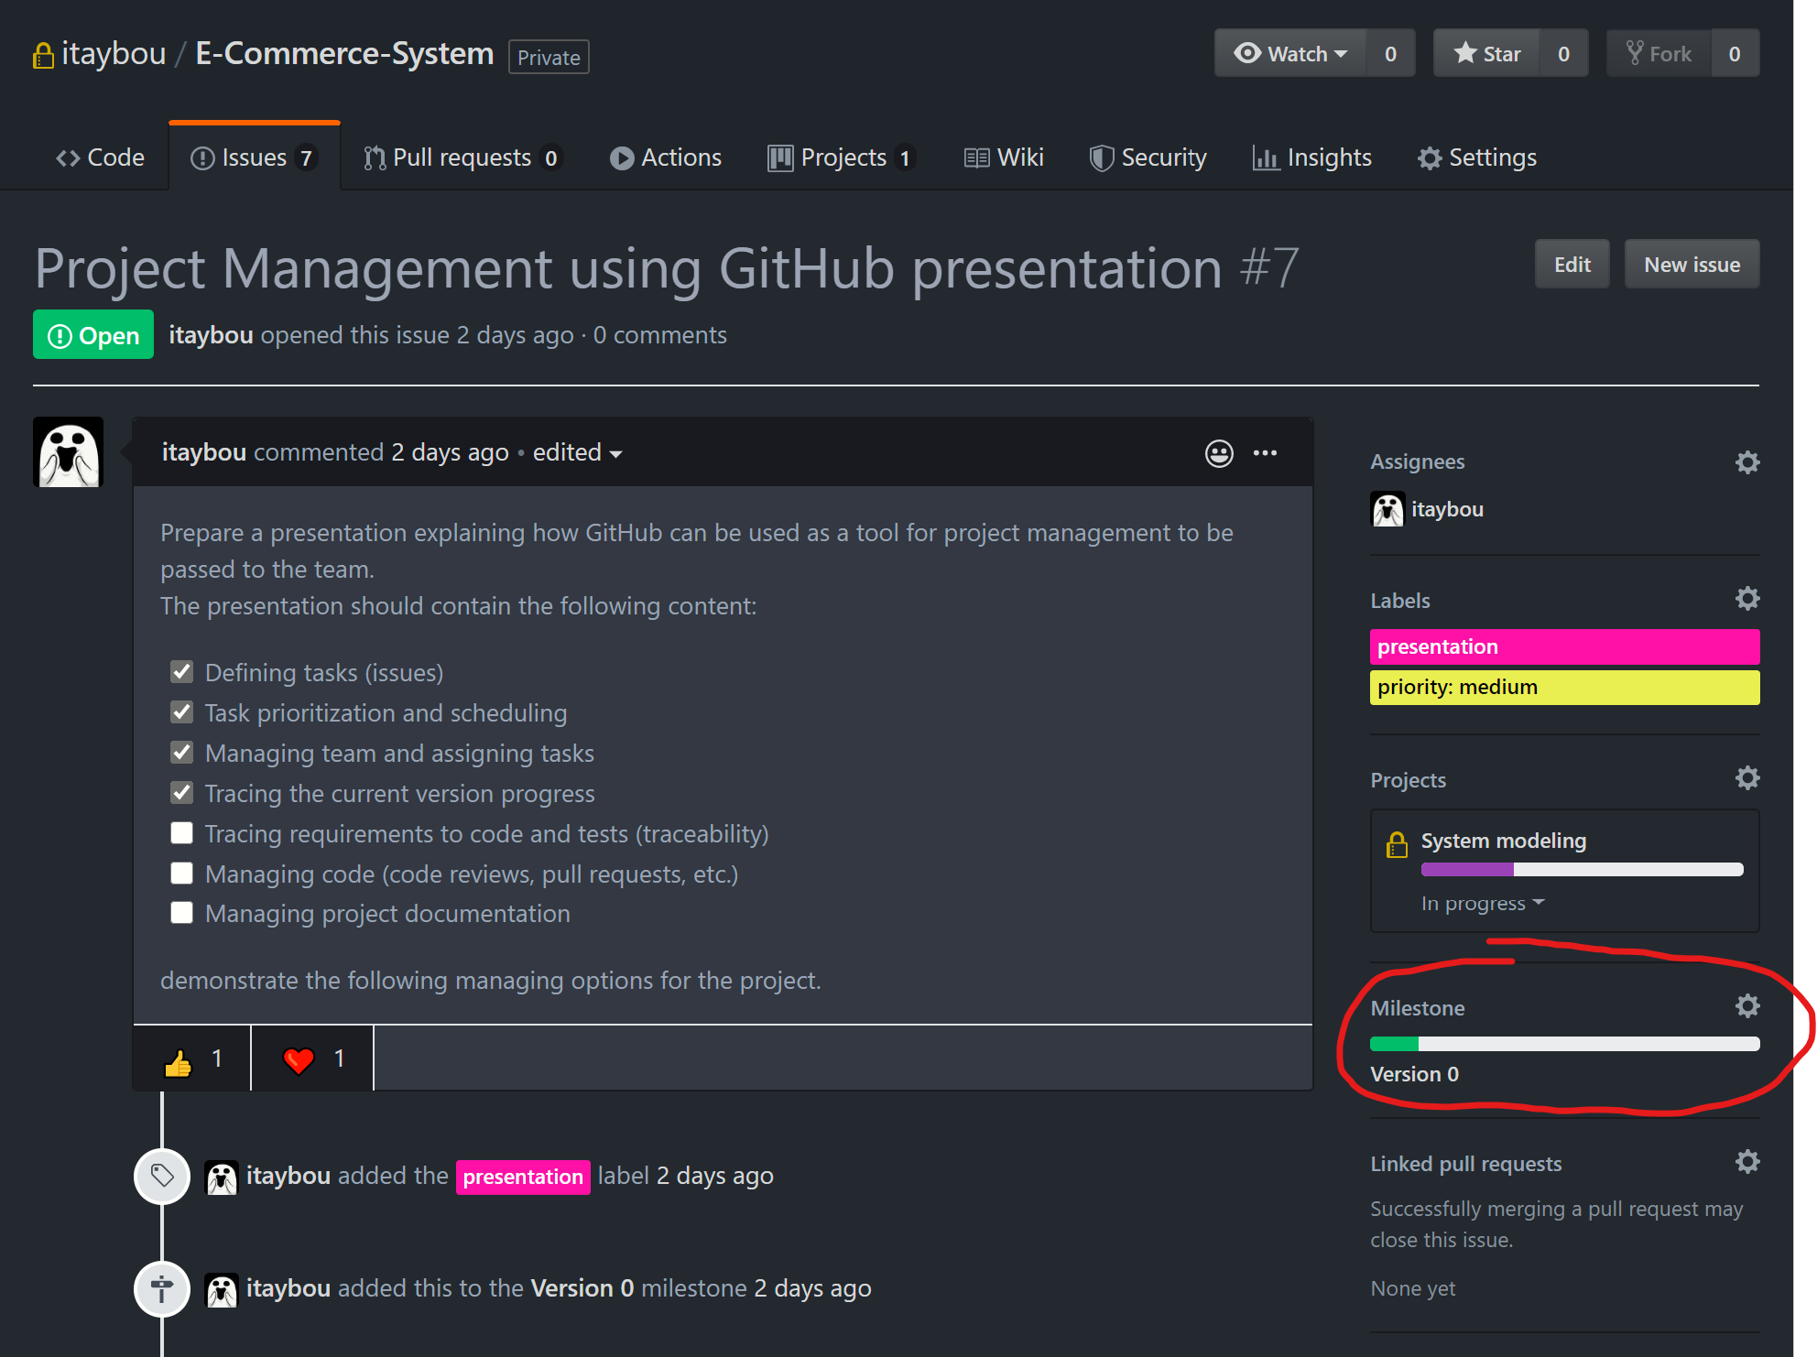
Scheduling tasks using milestones
Assign an issue to a milestone:

Slide 17
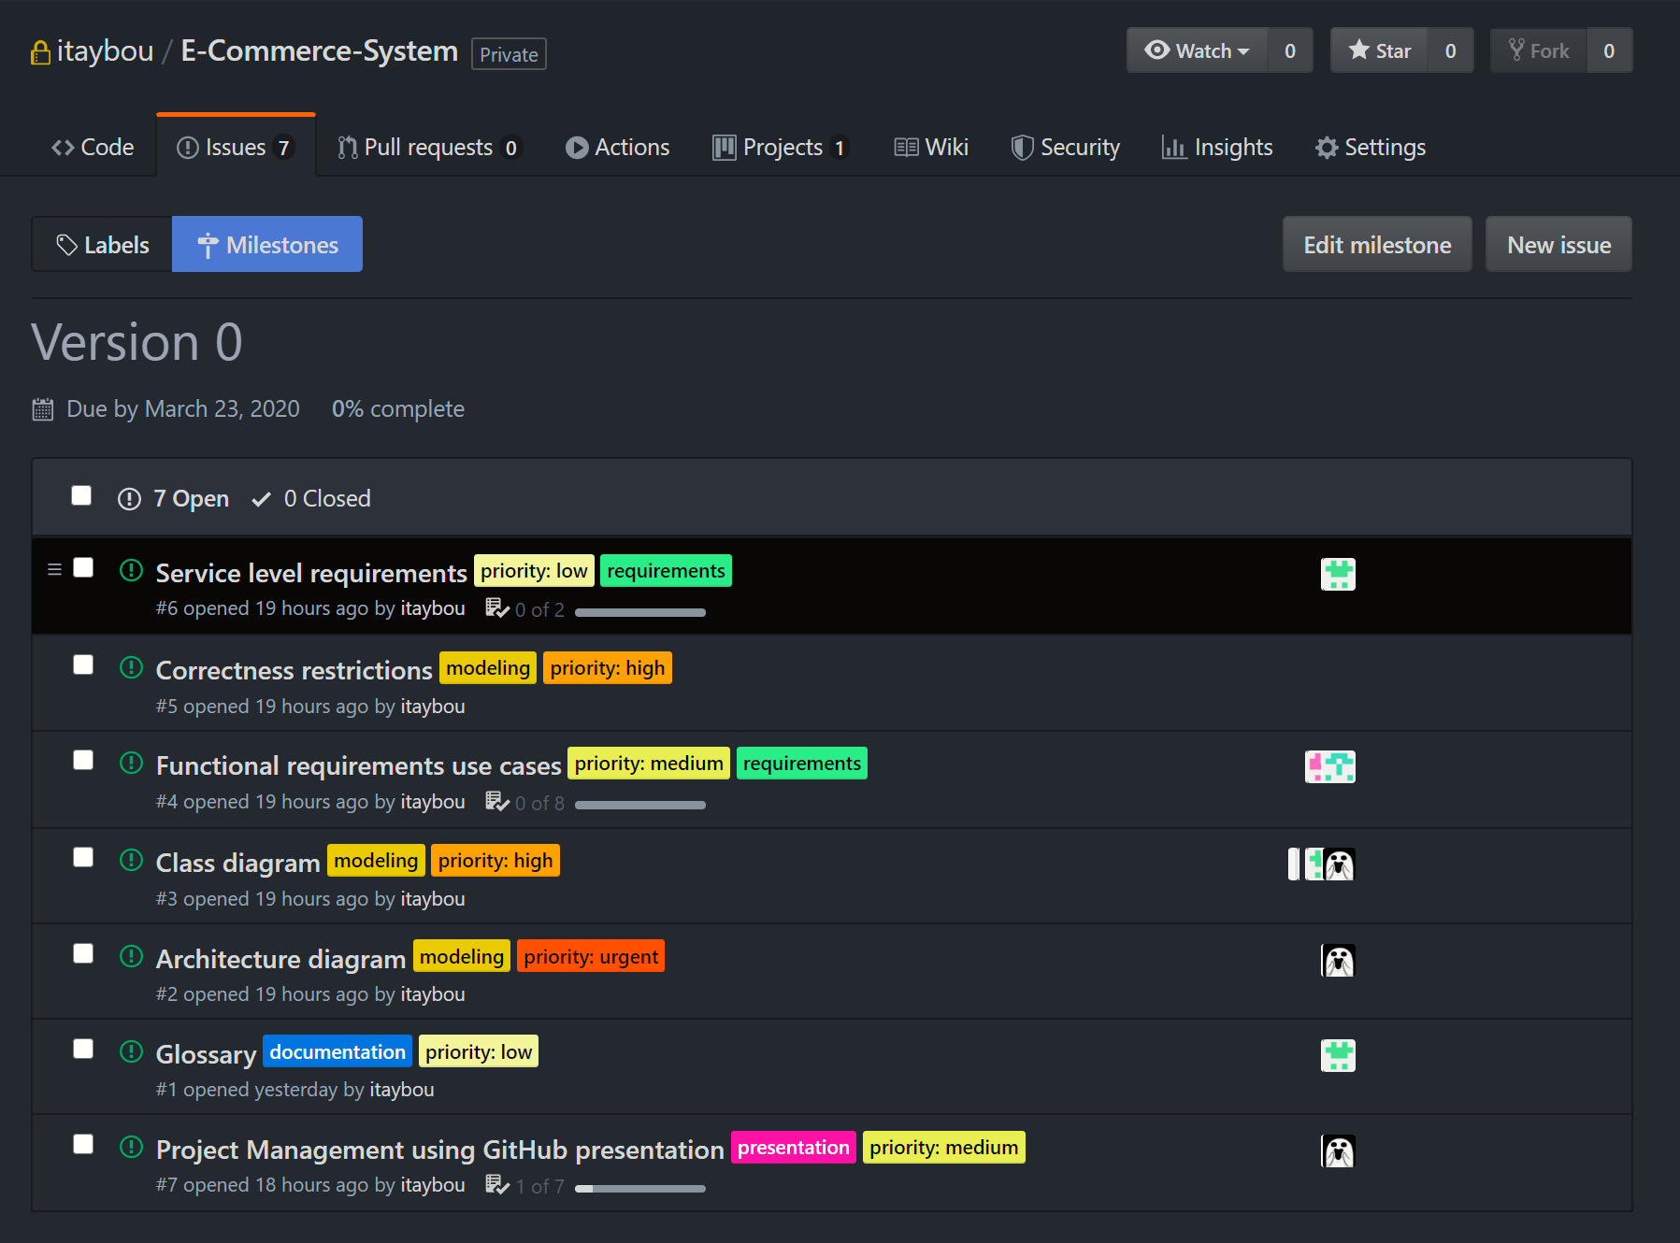
Scheduling tasks using milestones
By choosing a milestone you can view all issues and pull requests associated with it and the completion status.
Issues can be associated with a milestone on creation or by editing them and choosing the milestone to associate with.

Slide 18
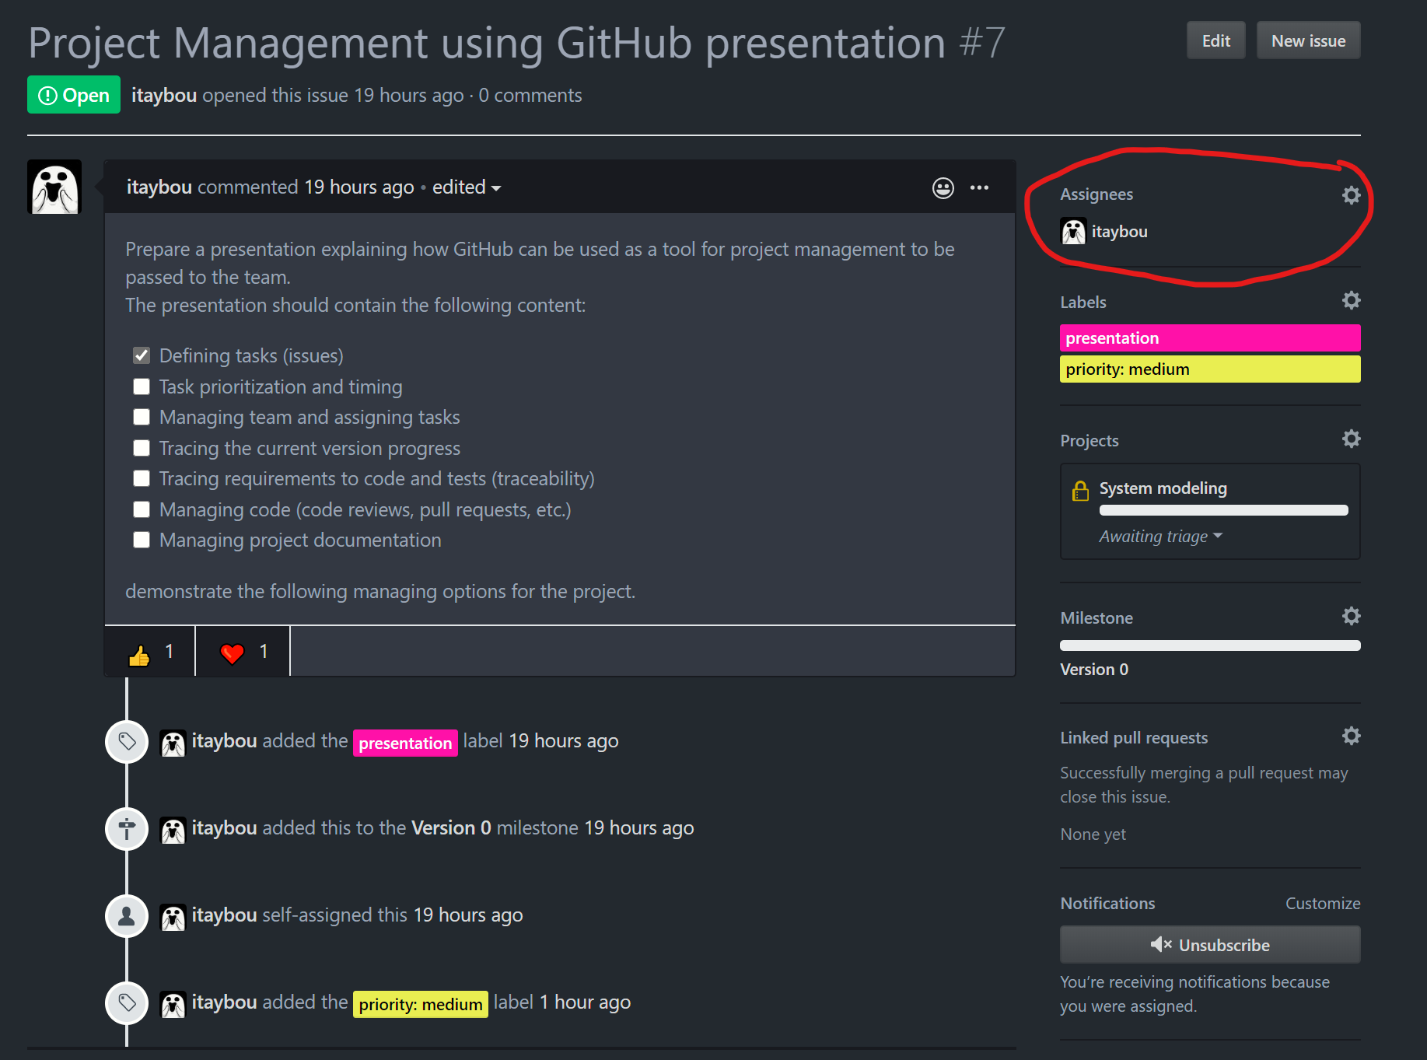
Assigning tasks to team members
Up to 10 team members can be assigned to work on an issue.
You can assign team members through the relevant issue page.
Using the issues assigning tool can result in a better team management and better division of tasks across the team.

Slide 19
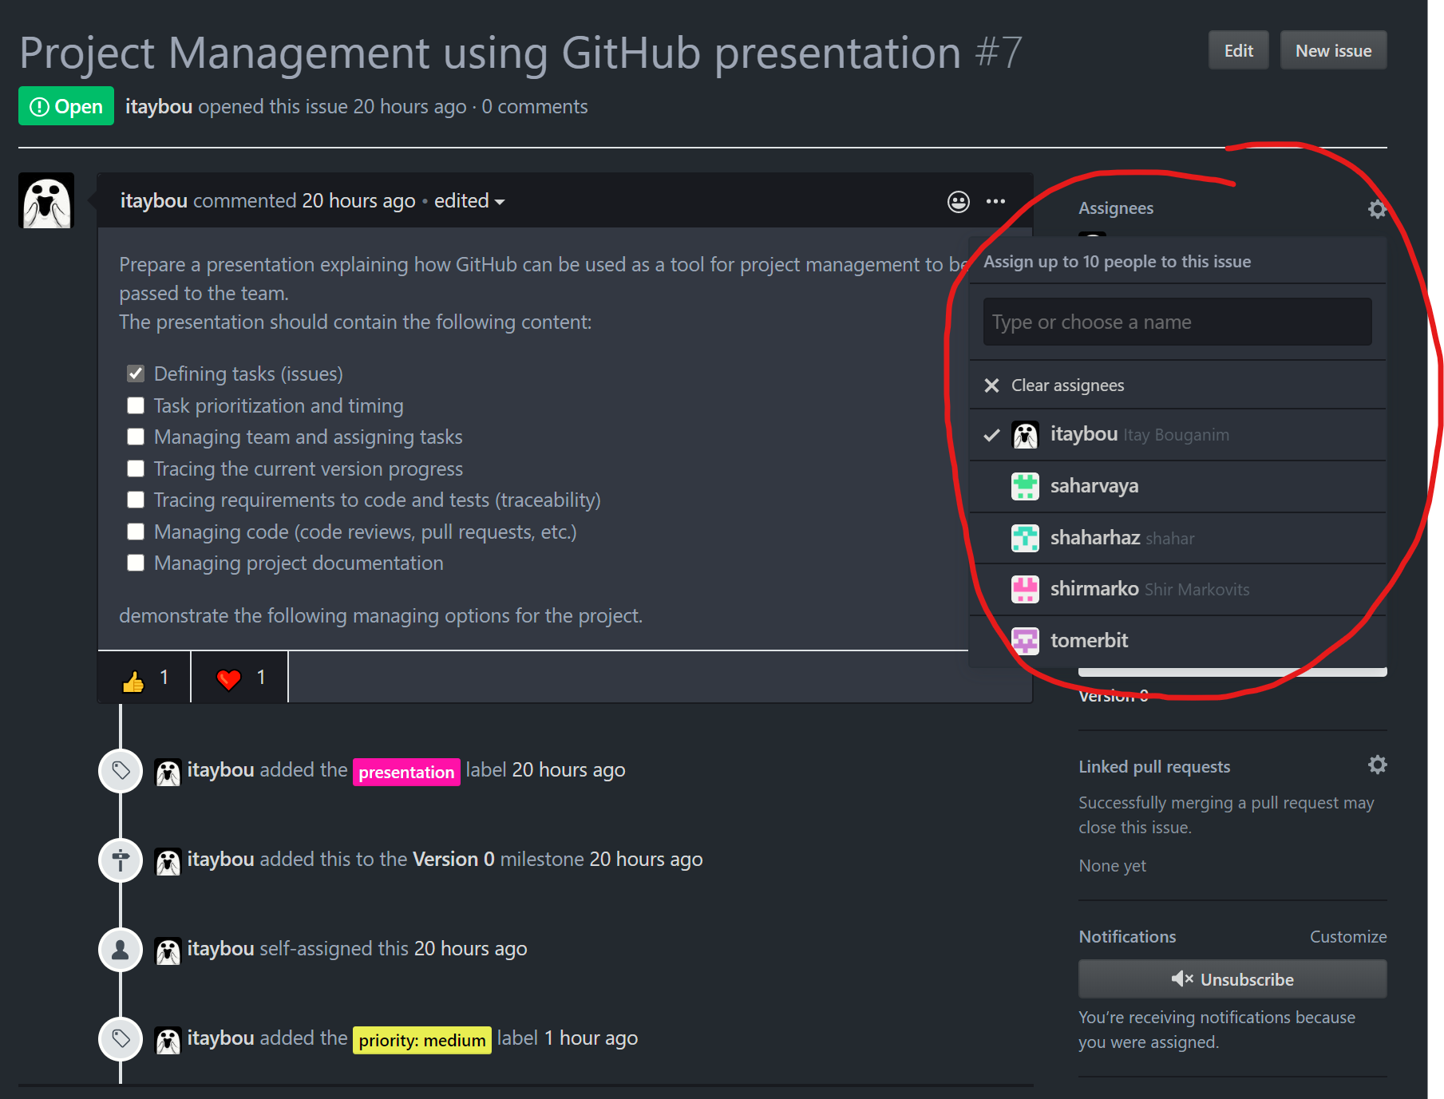
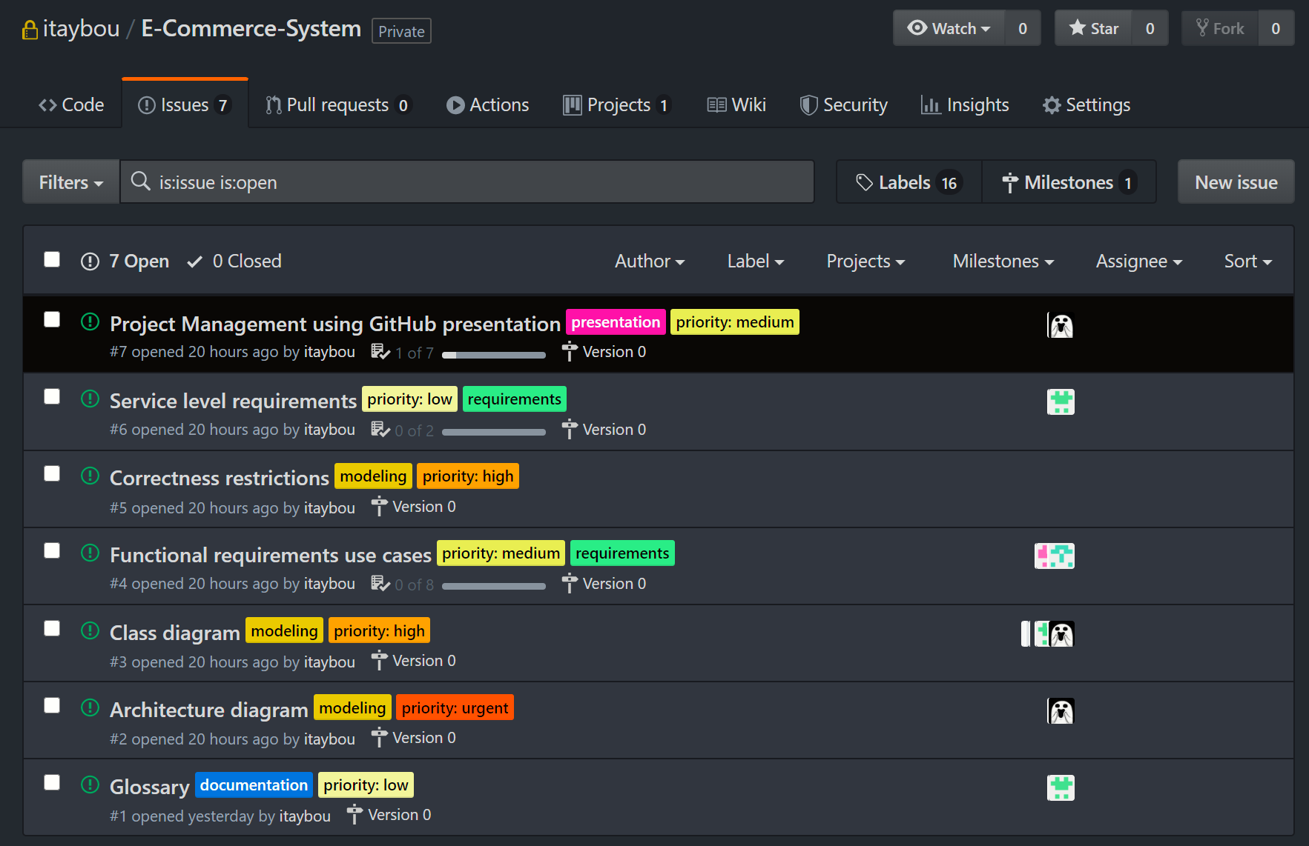
Assigning tasks to team members
Assigning team members to an issue
You can view/filter assignees for each issue

Slide 20
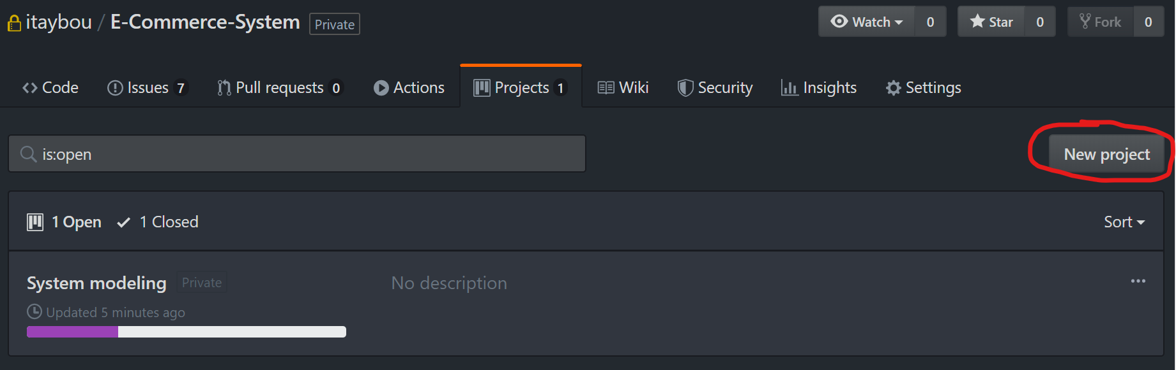
Use projects to track progress
Project boards on GitHub help you organize and prioritize your work. You can create project boards for specific feature work, comprehensive roadmaps, or even release checklists.
Project boards are made up of issues, pull requests, and notes that are categorized as cards in columns of your choosing. You can drag and drop or use keyboard shortcuts to reorder cards within a column, move cards from column to column, and change the order of columns.
Project progress meter
Create a new project

Slide 21
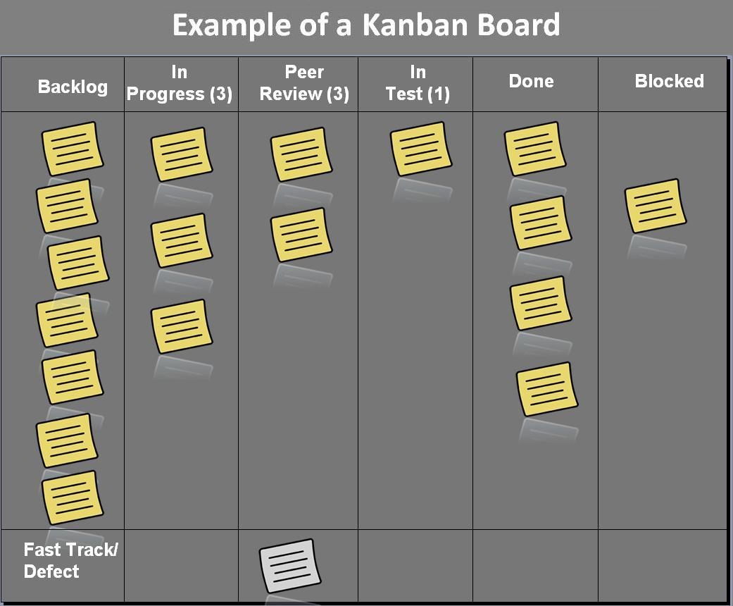
Use projects to track progress
Kanban boards
Organization, team, user, or repository level
Sort tasks
Plan your project
Automate your workflow
Track progress
Help you organize and prioritize your work. You can create project boards for specific feature work, comprehensive roadmaps, or even release checklists.
You can link multiple repositories to a project.

Slide 22
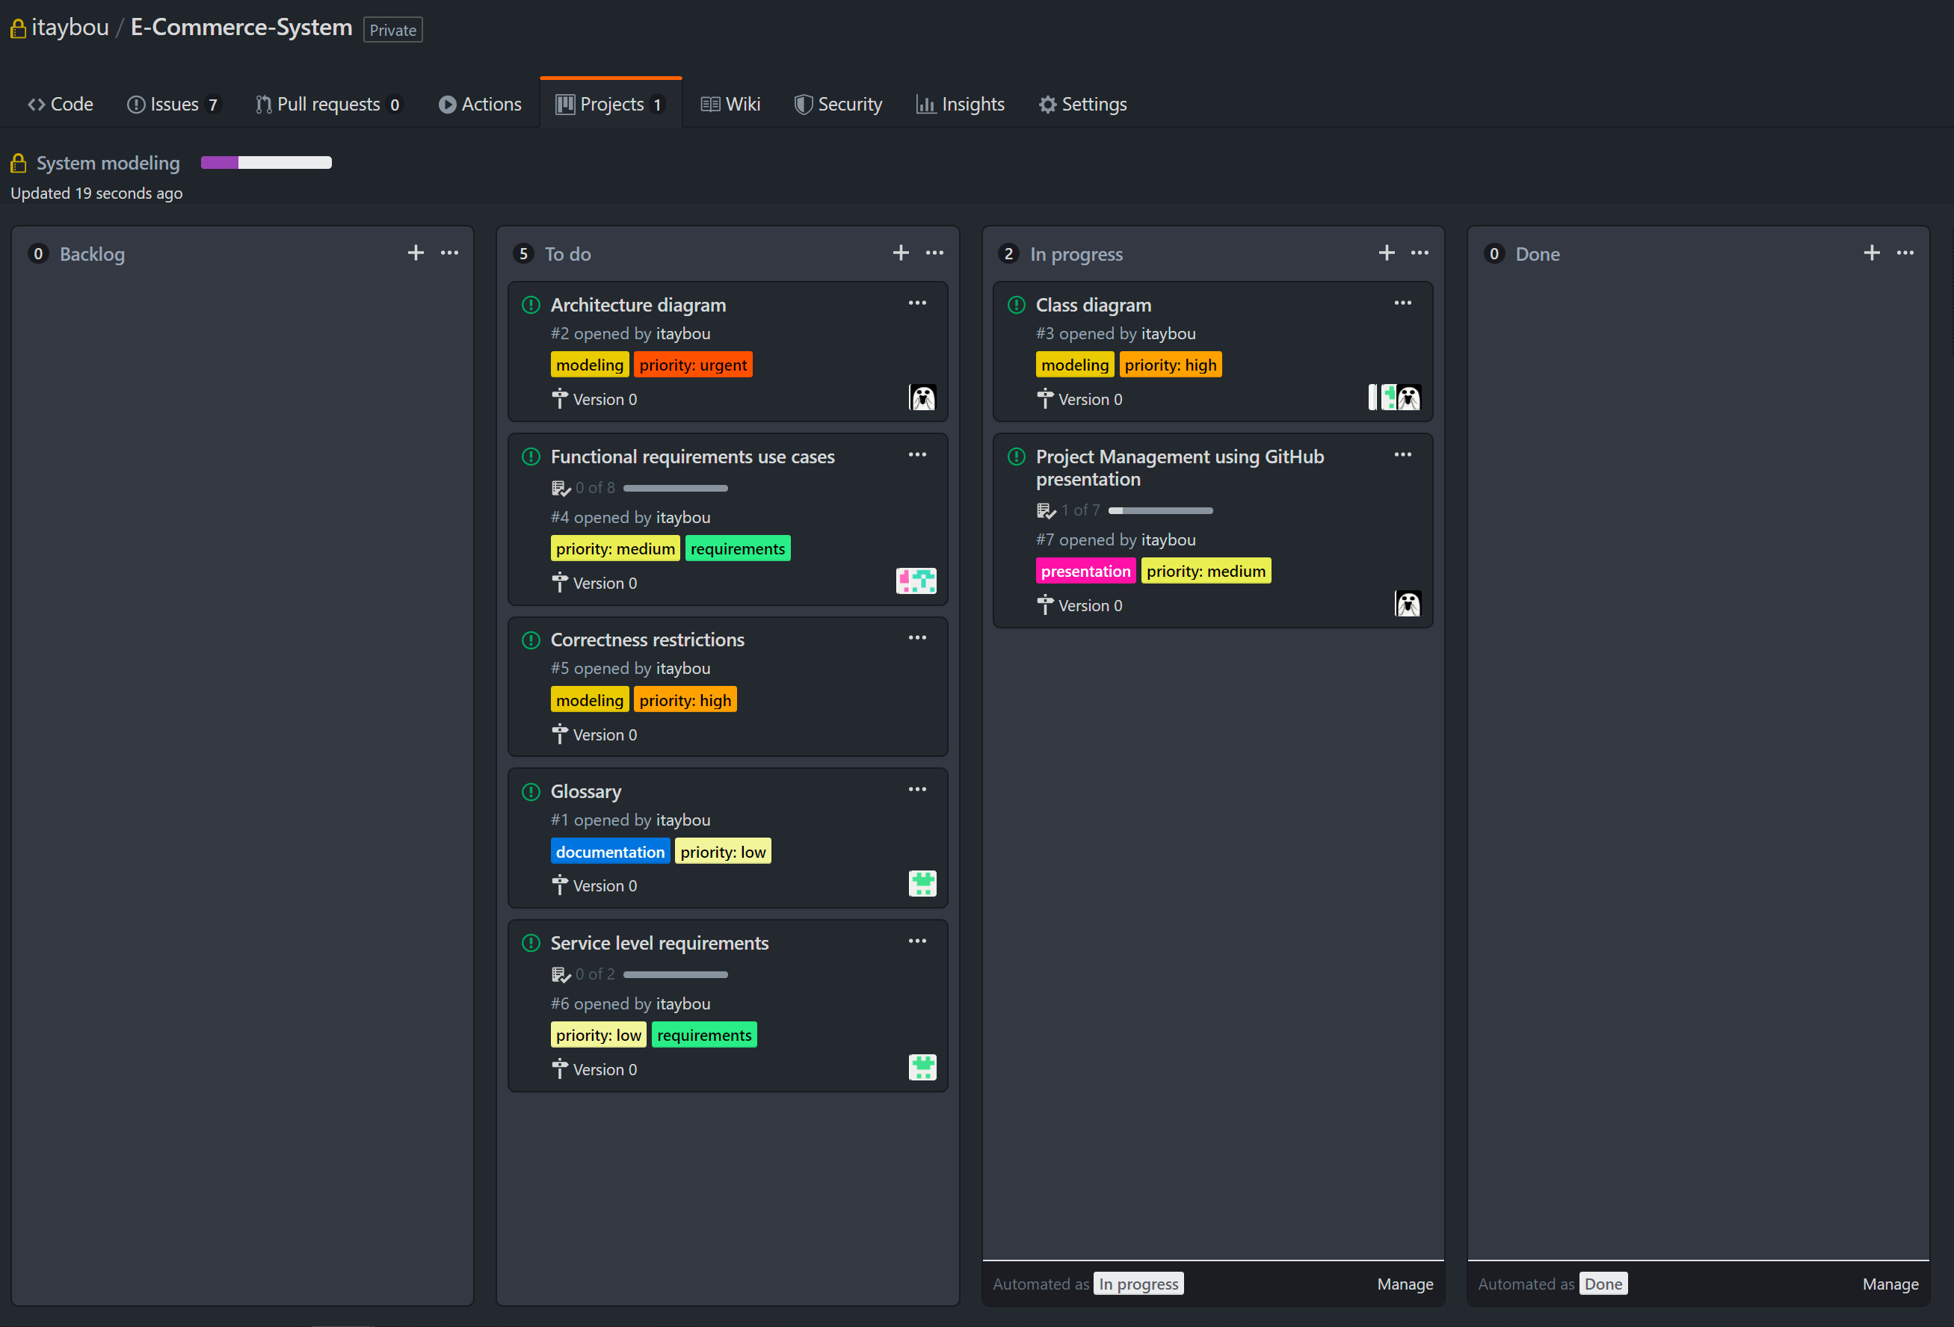
Use projects to track progress
After assigning the issues to the opened project you can manage the issues that need to be done, those that are currently in progress and those that are finished (or any other columns you wish to manage your issues and pull requests in).
Attending and closing issues affects the project progress meter.

Slide 23
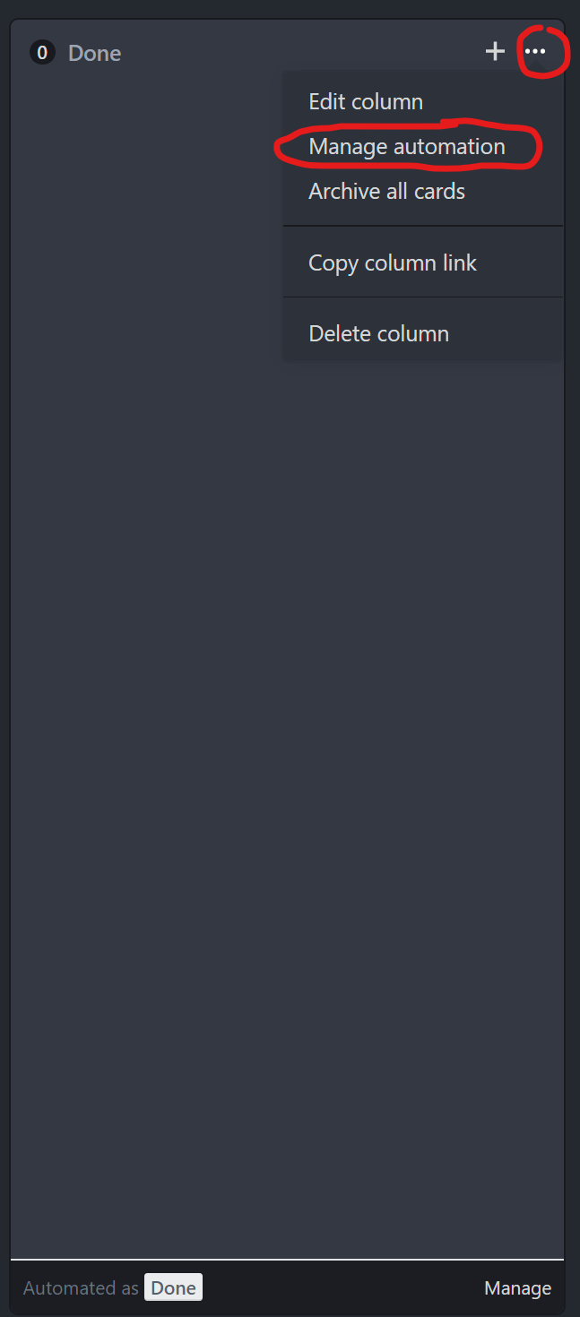
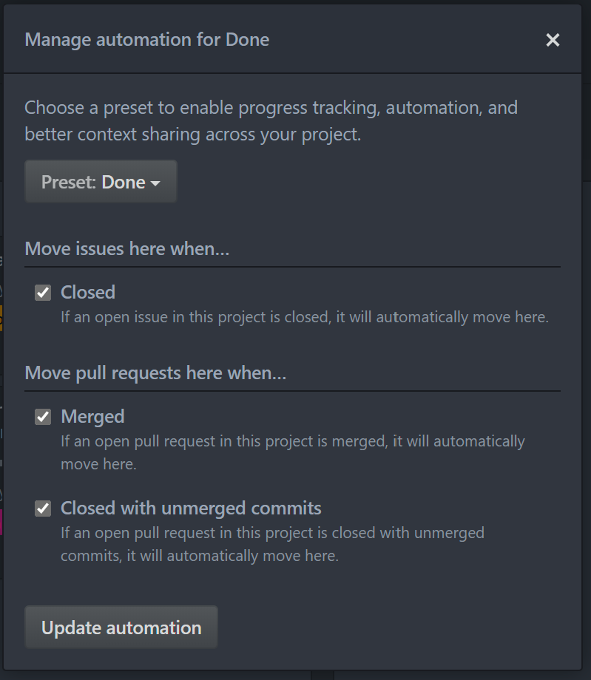
Use projects to track progress - Automation
Column switching of issues can be automated on events to some degree.
Examples:
You can automatically move an issue to the “Done” column when the issue is closed.
You can move pull requests to the “Done” column when the pull request is merged (pull requests will be discussed later).
You can move pull requests to the “In Progress” column automatically when they are added.
And many more automation options.

Slide 24
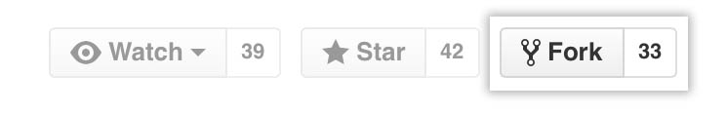
About pull requests
Pull requests let you tell others about changes you've pushed to a branch in a repository on GitHub. Once a pull request is opened, you can discuss and review the potential changes with collaborators and add follow-up commits before your changes are merged into the base branch.
There are 2 main workflows when dealing with pull requests:
1. Pull Request from a forked repository
2. Pull Request from a branch within a repository
Here we are going to focus on 2.
A fork is a copy of a repository. Forking a repository allows you to freely experiment with changes without affecting the original project.

Slide 25
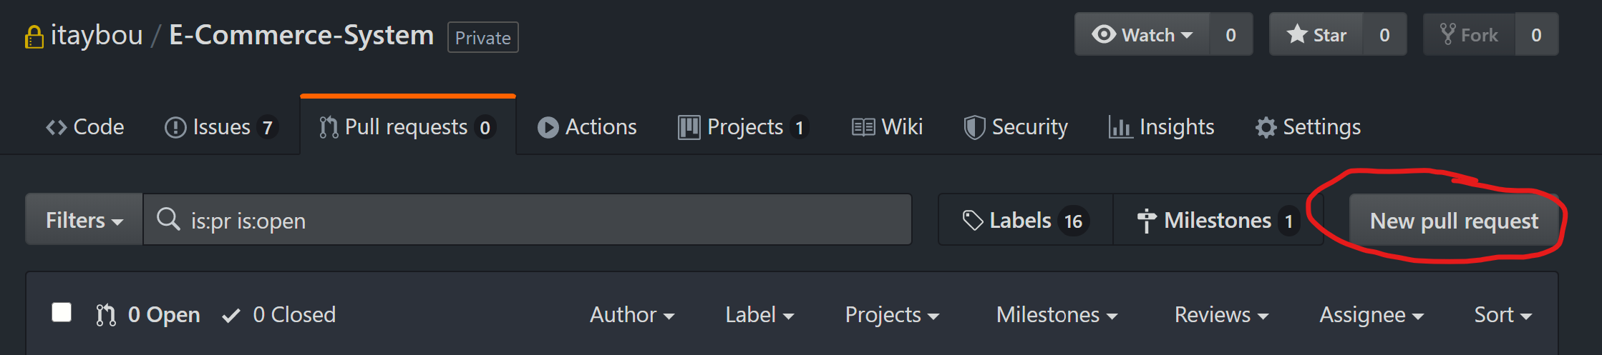
About pull requests
Creating a Pull Request
To create a pull request, you must have changes committed to the new branch.
Go to the repository page on GitHub and click on "Pull Request" button in the repo header.

Slide 26
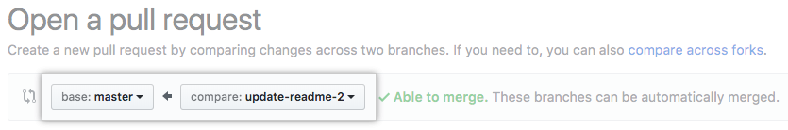
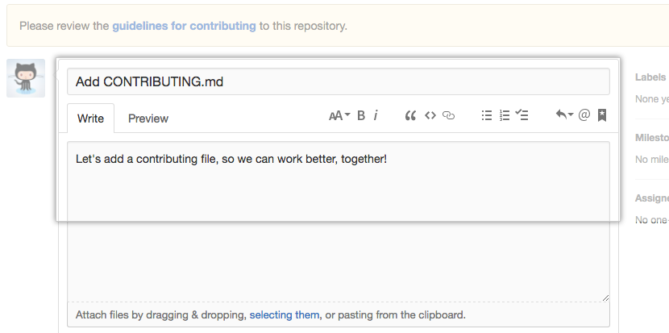
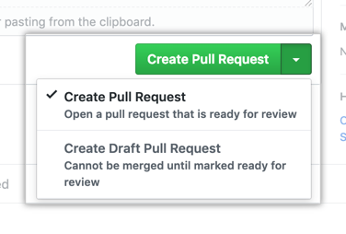
About pull requests
Use the base branch dropdown menu to select the branch you'd like to merge your changes into, then use the compare branch drop-down menu to choose the topic branch you made your changes in.
Type a title and description for your pull request.
Click Create pull request.

Slide 27
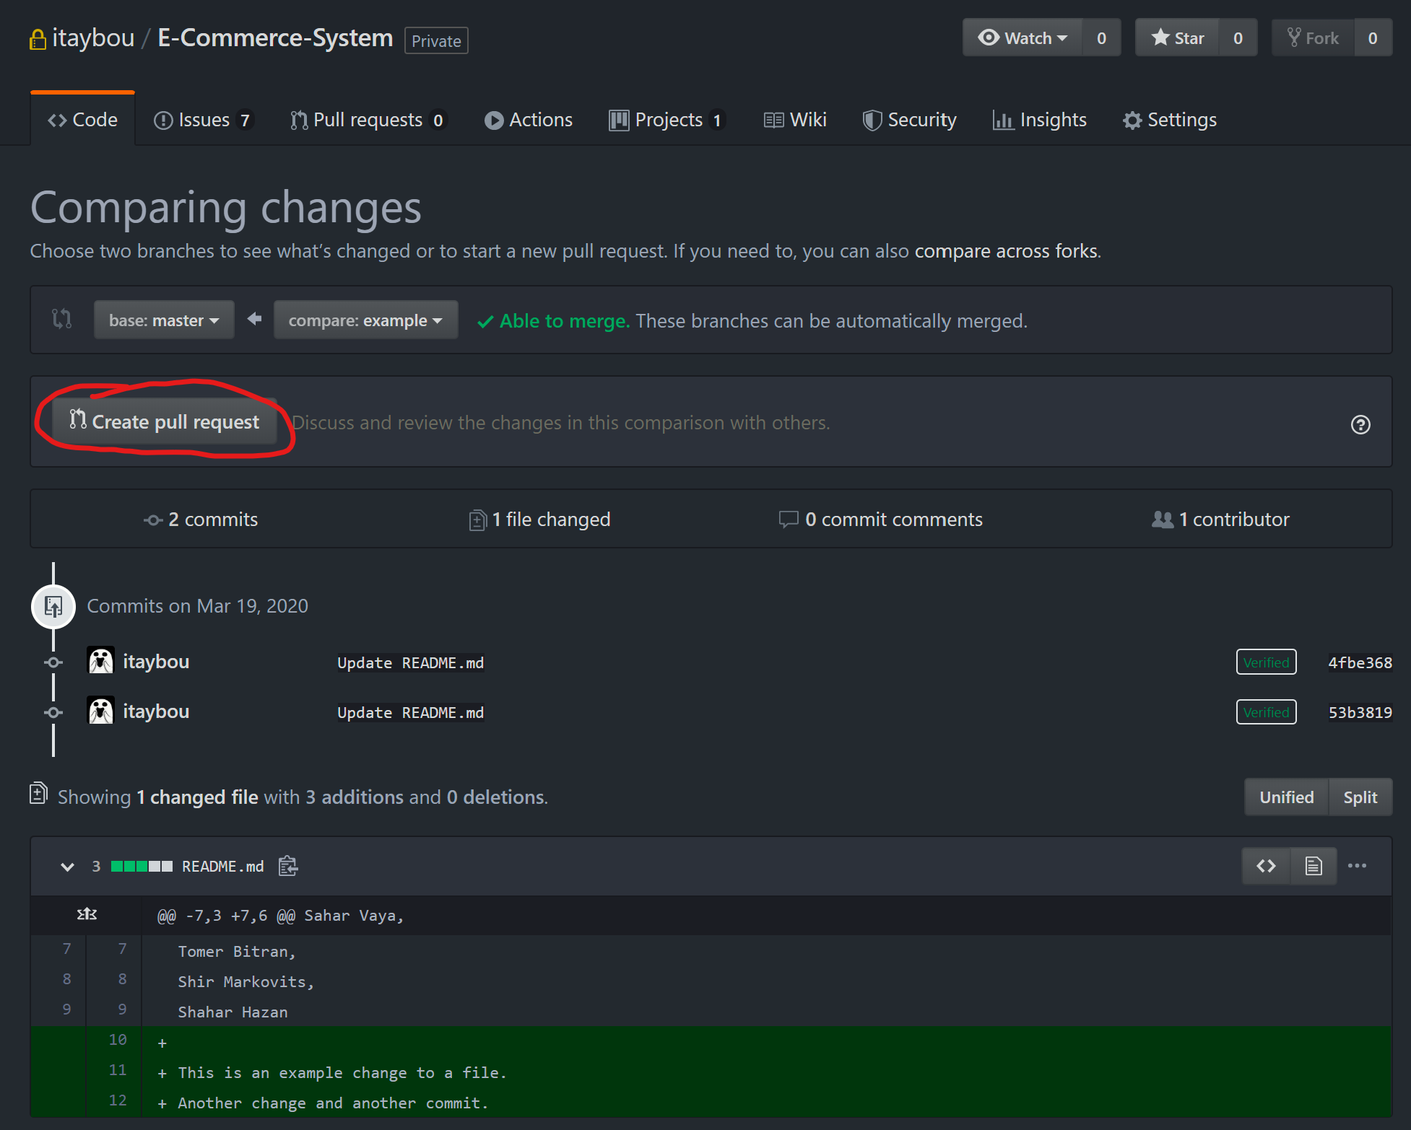
About pull requests
Pull request creation page.

Slide 28
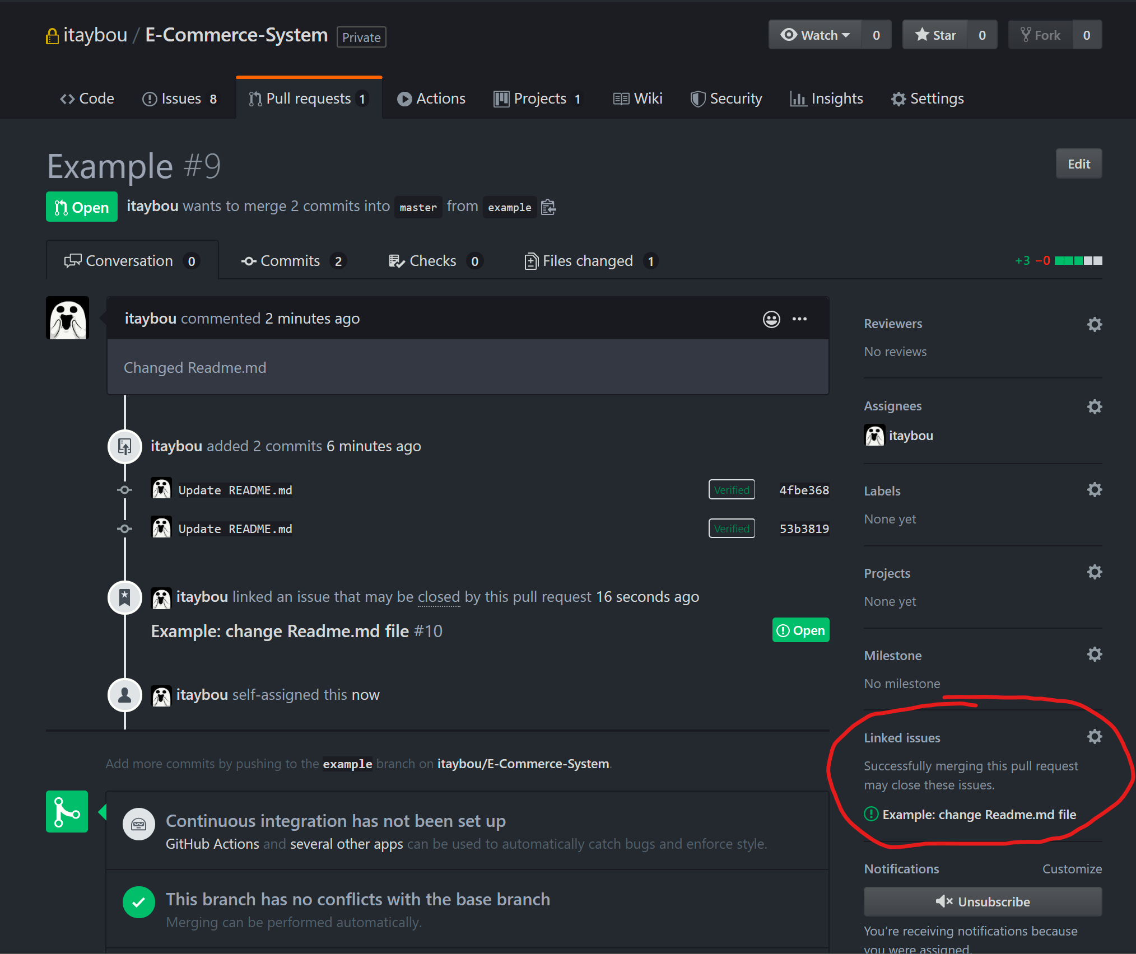
Traceability between requirements to code
Assuming we have an open issue for each relevant requirement.
We can link an issue to a pull request in order to trace changes made to relevant code or tests added in order to handle the requirement associated with that specific issue.
You can view the files changed, code added, changed or deleted and files associated with the appropriate tests in this pull request.
We can view/change linked issues to this pull request

Slide 29
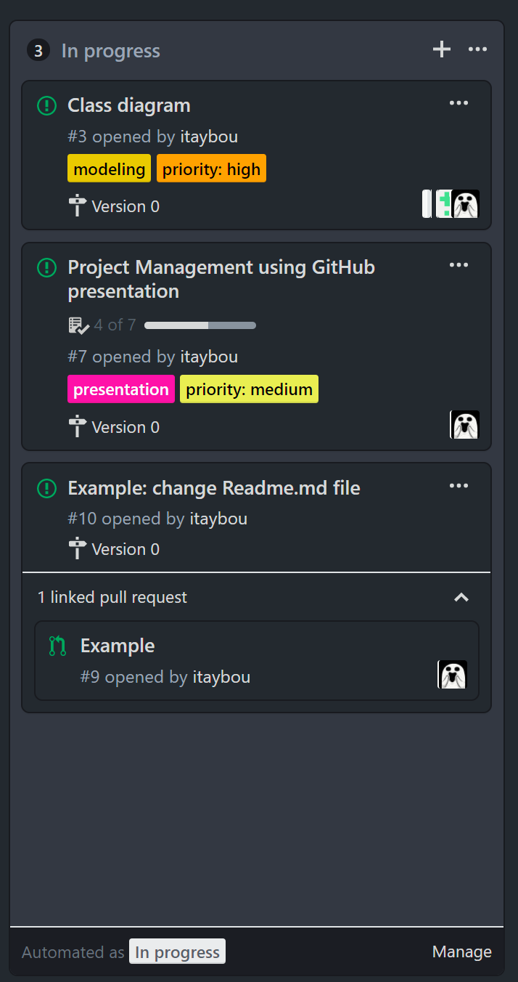
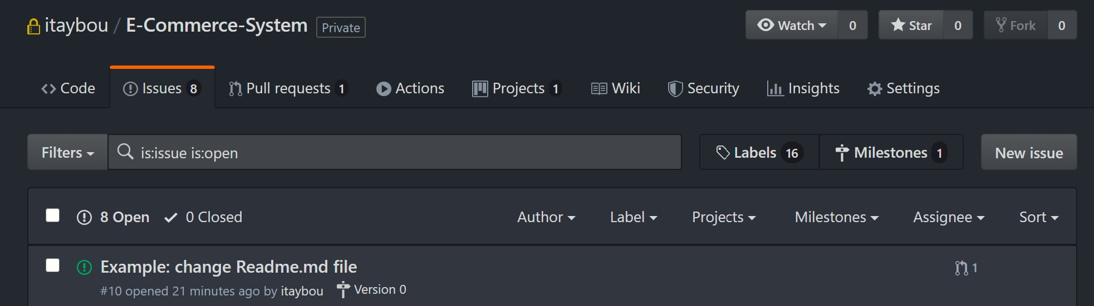
Traceability between requirements to code
Pull request associated with an issue (with relevant changes to code) can be viewed through the project board.
We can also view the pull requests associated with the issue from the issues page.

Slide 30
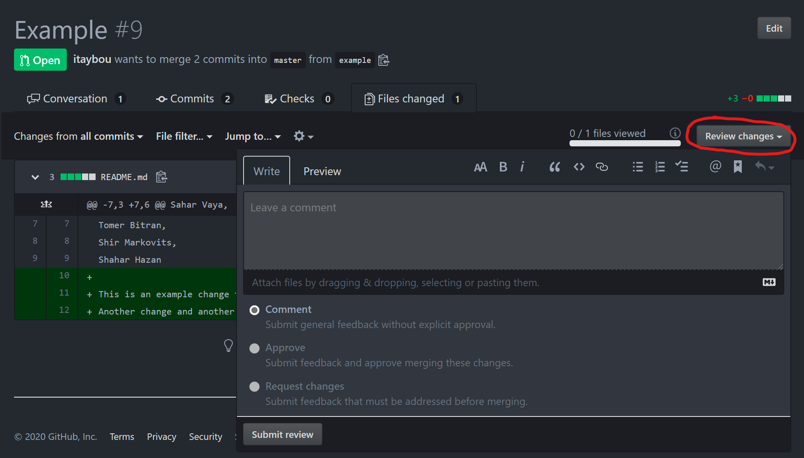
Code reviews and pull requests
Start a new feature or propose a change to existing code with a pull request—a base for your team to coordinate details and refine your changes.
Comment, approve or request changes to code changes/additions associated to a pull request easily

Slide 31
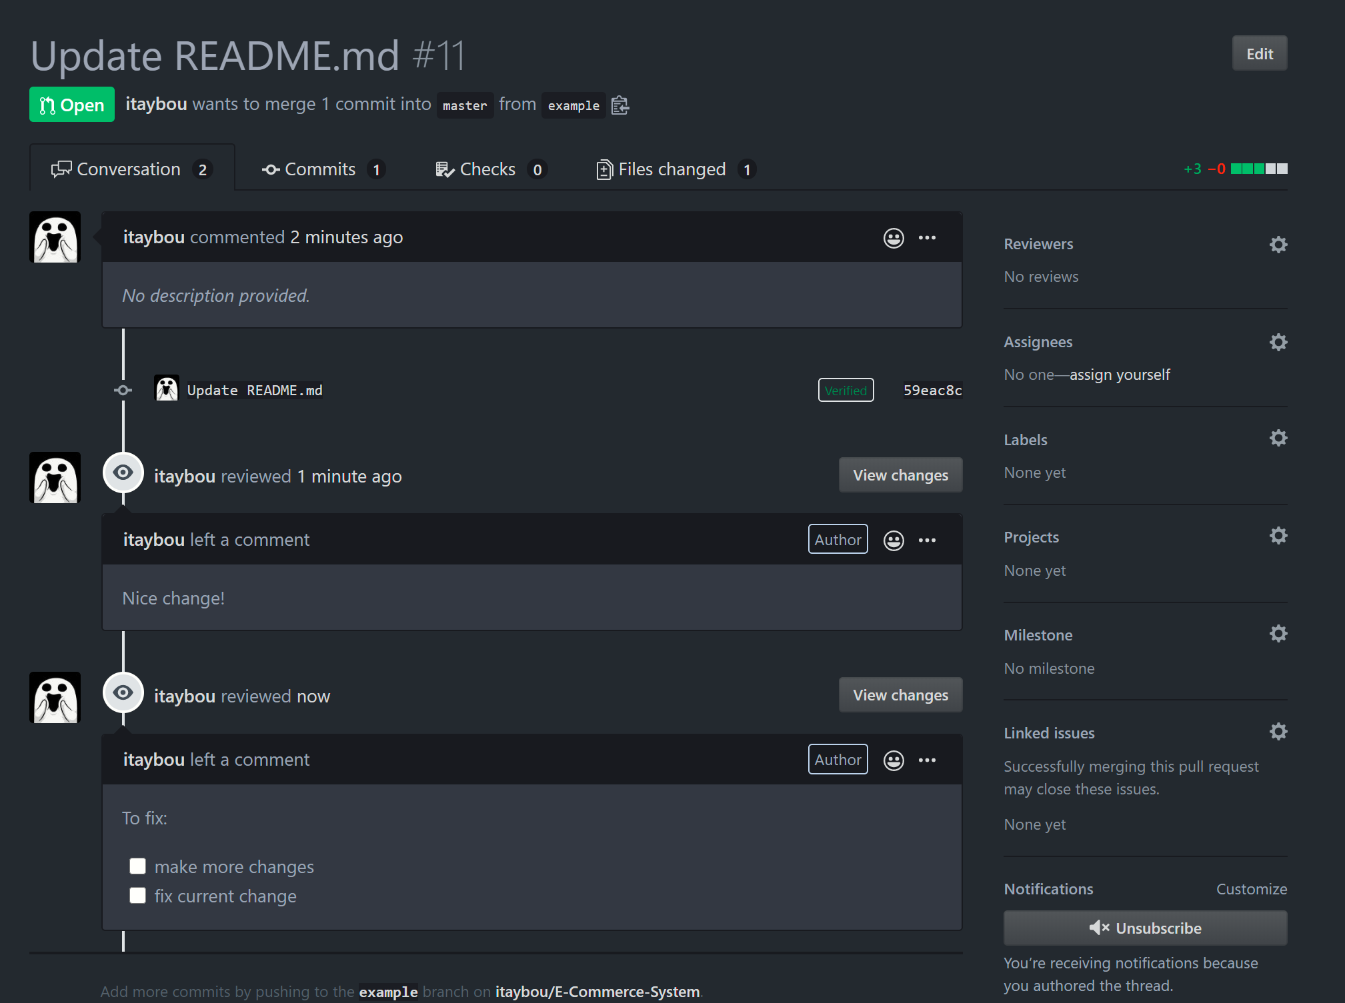
Code reviews and pull requests
Discussion and reviews over a pull request

Slide 32
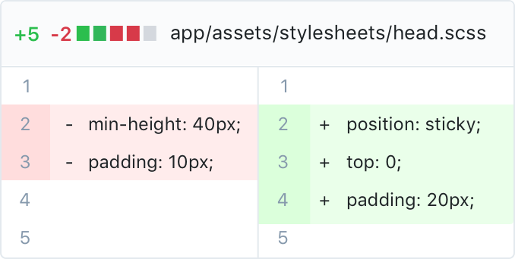
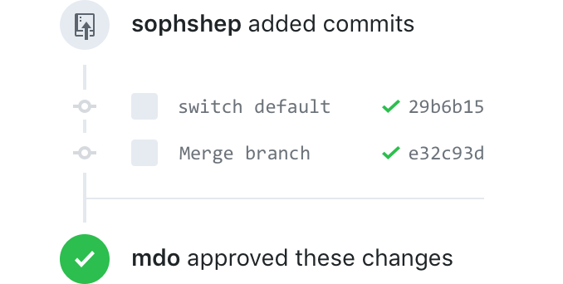
Code reviews and pull requests
See updates made in the pull request
Diff tool - Preview changes in context with your code to see what is being proposed. Side-by-side Diffs highlight added, edited, and deleted code right next to the original file, so you can easily spot changes.
History - Browse commits, comments, and references related to your pull request in a timeline-style interface. Your pull request will also highlight what’s changed since you last checked.

Slide 33
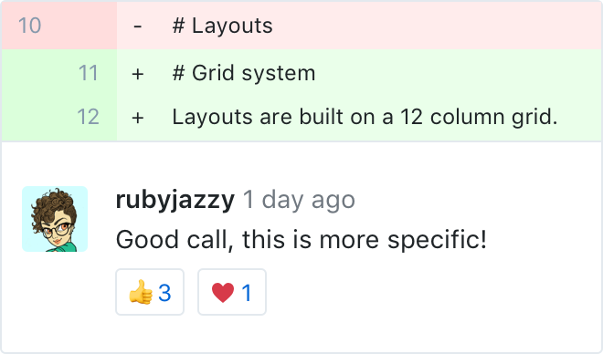
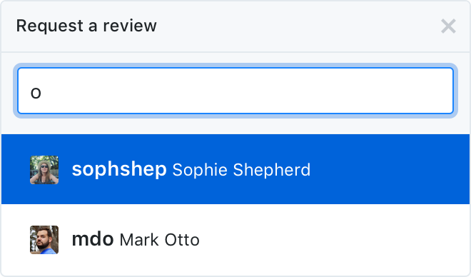
Code reviews and pull requests
Discuss code
Comments - On GitHub, conversations happen alongside your code. Leave detailed comments on code syntax and ask questions about structure inline.
Review requests - If you’re on the other side of the code, requesting peer reviews is easy. Add users to your pull request, and they’ll receive a notification letting them know you need their feedback.

Slide 34
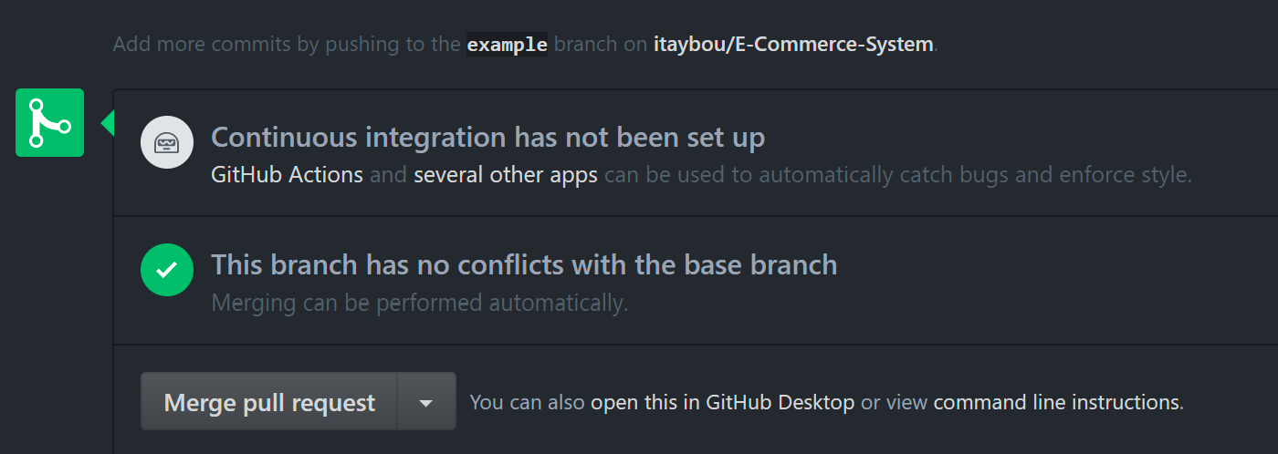
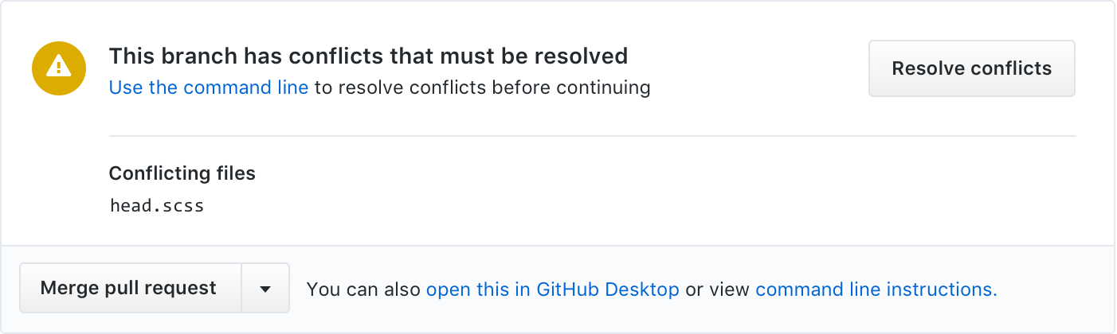
Code reviews and pull requests
Now after your pull request has been reviewed and approved by the team members you can merge it back to the original branch (if no conflicts with current code exist).
Resolve simple conflicts –
You can’t always avoid conflict. Merge pull requests faster by resolving simple merge conflicts on GitHub—no command line necessary.

Slide 35
Managing project documentation
GitHub README file - You can add a README file to your repository to tell other people why your project is useful, what they can do with your project, and how they can use it.
A README is often the first item a visitor will see when visiting your repository. README files typically include information on:
If you put your README file in your repository's root, docs, or hidden .github directory, GitHub will recognize and automatically surface your README to repository visitors.
What the project does
Why the project is useful
How users can get started with the project
Where users can get help with your project
Who maintains and contributes to the project

Slide 36
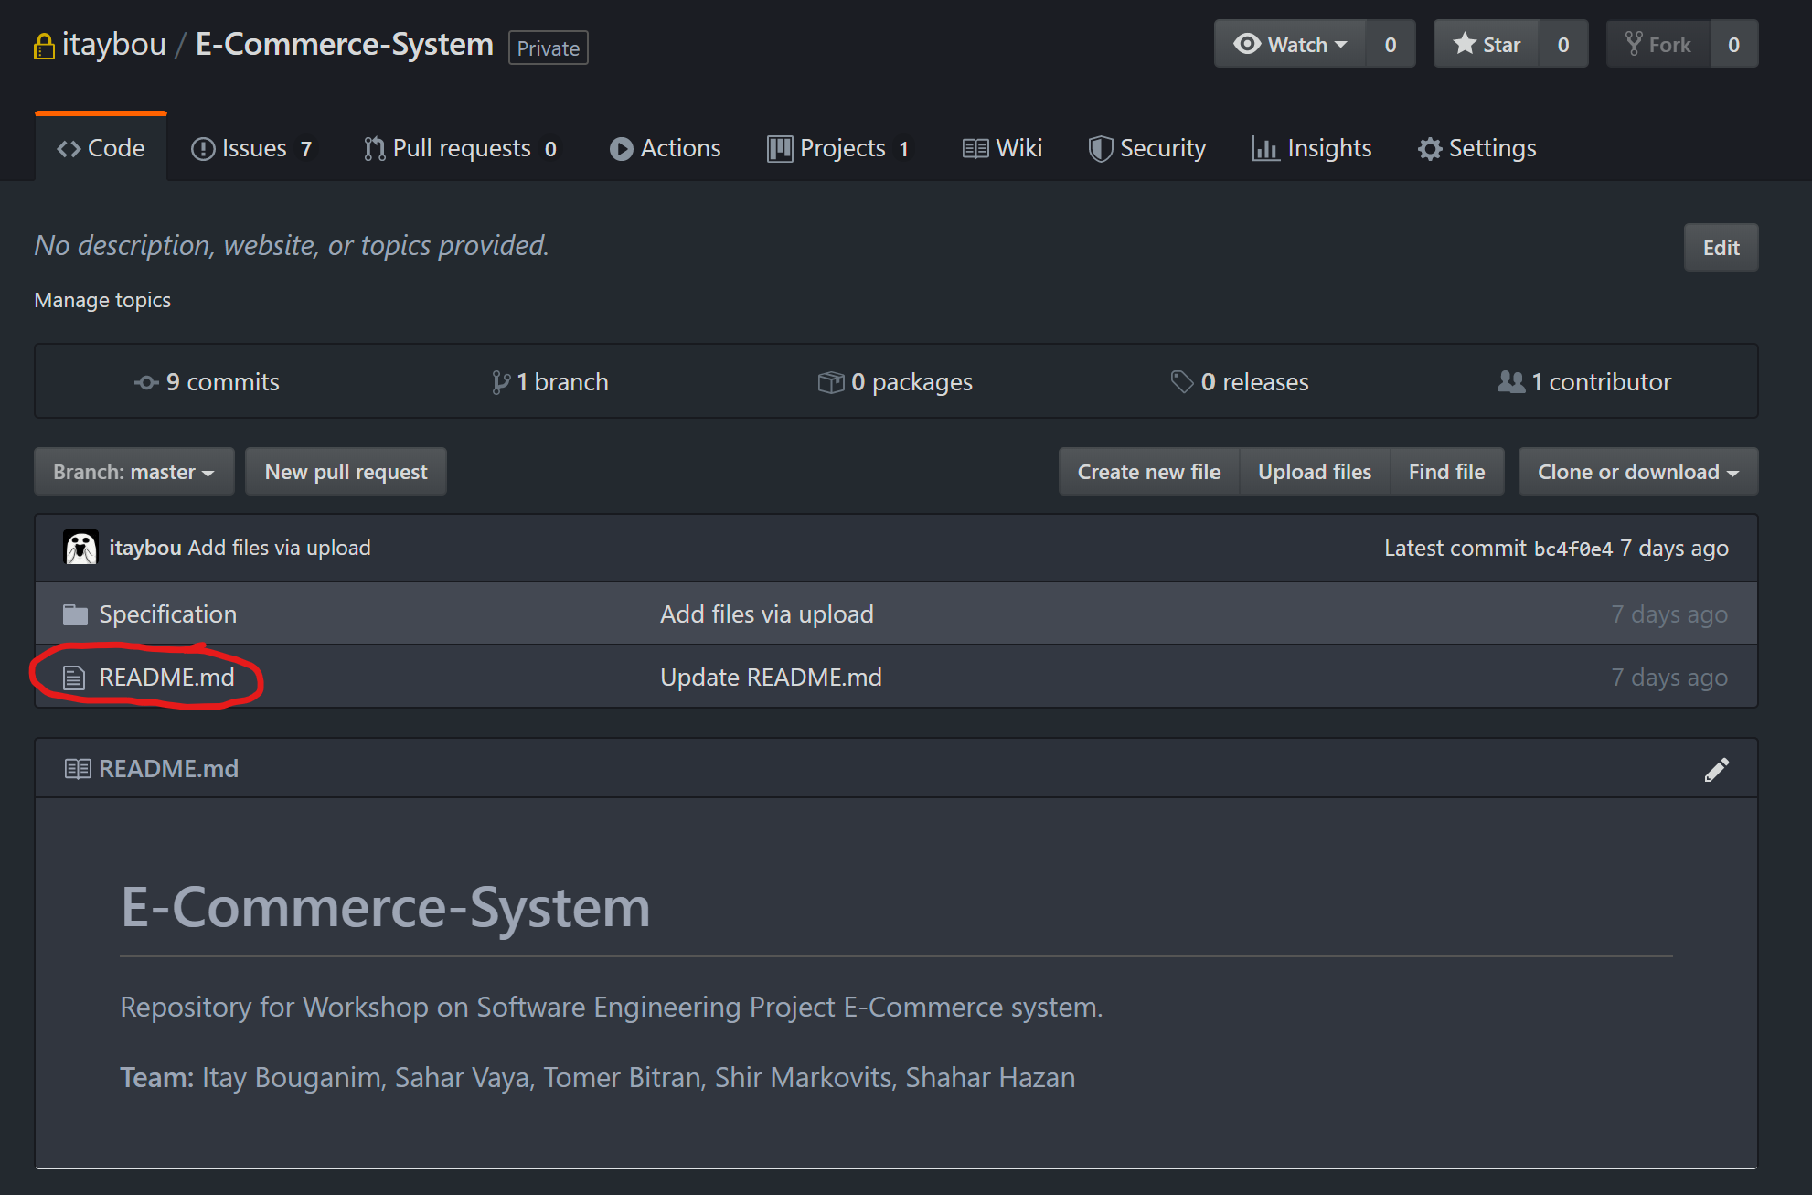
Managing project documentation
Displays the content of the README.md file

Slide 37
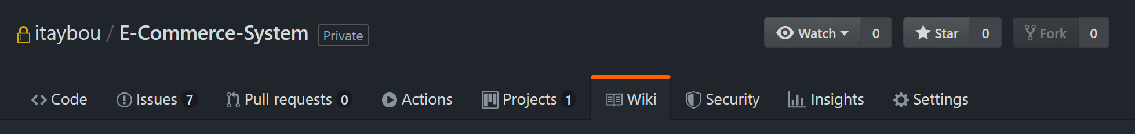
Managing project documentation
GitHub Wikis - You can host documentation for your repository in a wiki, so that others can use and contribute to your project.
Every GitHub repository comes equipped with a section for hosting documentation, called a wiki. You can use your repository's wiki to share long-form content about your project, such as how to use it, how you designed it, or its core principles.
With wikis, you can write content just like everywhere else on GitHub (Supports Markup, links, photos, and code fragments).

Slide 38
Managing project documentation
Difference between Wikis and README.md - A README file quickly tells what your project can do, while you can use a wiki to provide additional documentation and comprehensive details about your project.
Wiki features:
Wiki content is designed to be easily editable. You can add or change content on any wiki page by clicking the Edit button located in the upper right corner of each page. This opens up the wiki editor.
Wikis also give you the option of including a custom footer where you can list things like contact details or license information for your project.
You can add additional pages to your wiki by selecting New Page in the upper right corner. By default, each page you create is included automatically in your wiki’s sidebar and listed in alphabetical order.
You can also add a custom sidebar to your wiki by clicking the Add custom sidebar link. Custom sidebar content can include text, images, and links.

Slide 39
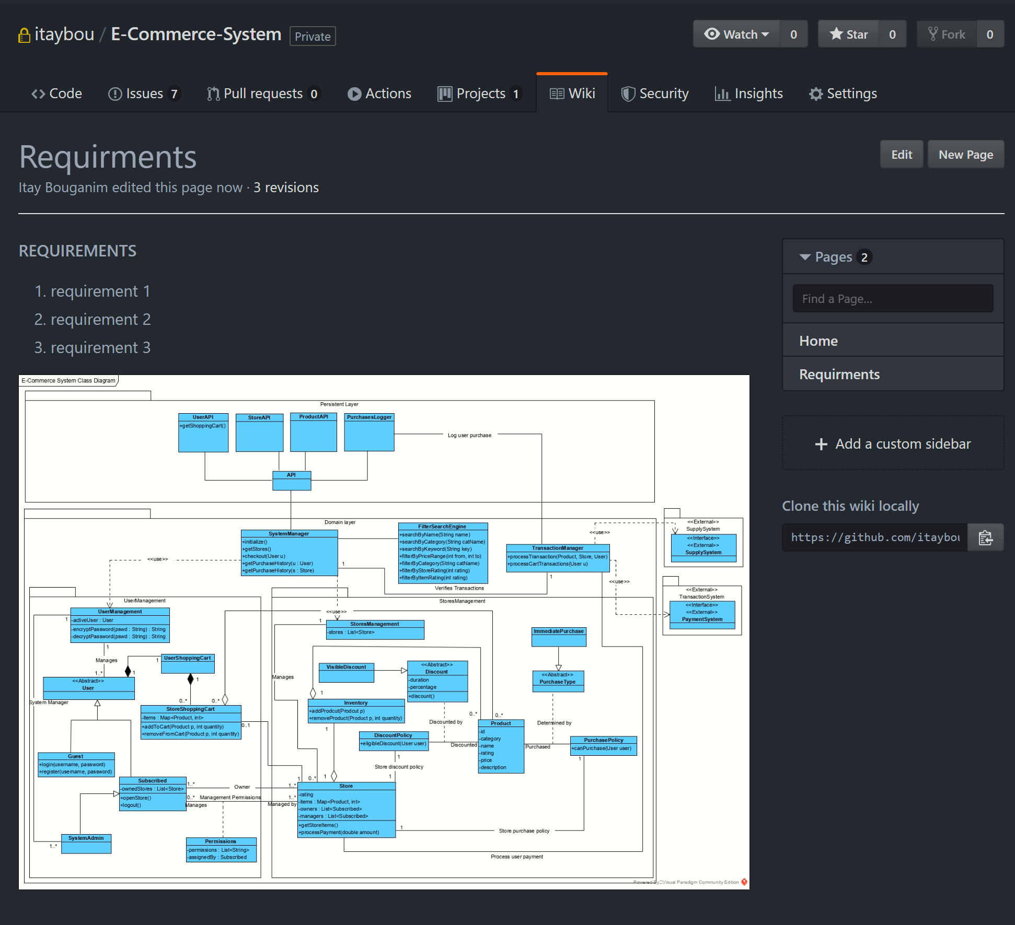
Managing project documentation
Changes made to the page
Add a new page
Page content
Current wiki pages
Optional side bar
Additional custom footer can be presented under each page

Slide 40
Questions?

